Slide 1

Closing the Gap
Information Repository
July 2024 Dashboard update
2024 Annual Data Compilation Report
Selwyn Button, Commissioner
Natalie Siegel-Brown, Commissioner

Slide 2

Acknowledgement of Country

Slide 3

Presentation outline
Our role
Key developments to the ADCR and dashboard in 2024
Key messages
Relevance to the CtG Review

Slide 4
The role of the Commission in the National Agreement
PUBLIC ACCOUNTABILITY FRAMEWORK (SECTION 9)
Dashboard
Jurisdictions Annual Report
Productivity Commission Review
Annual Data Compilation Report
Response by
Joint Council
Coalition of Peaks Report
Aboriginal and Torres Strait Islander led Review

Slide 5
Developments in the
2024 ADCR
Addition of historical and ongoing context, recognising the contributions and resilience of Aboriginal and Torres Strait Islander people
A thematic approach to reporting outcomes, highlighting interconnectedness of outcome areas
Clear picture of data availability and gaps

Slide 6

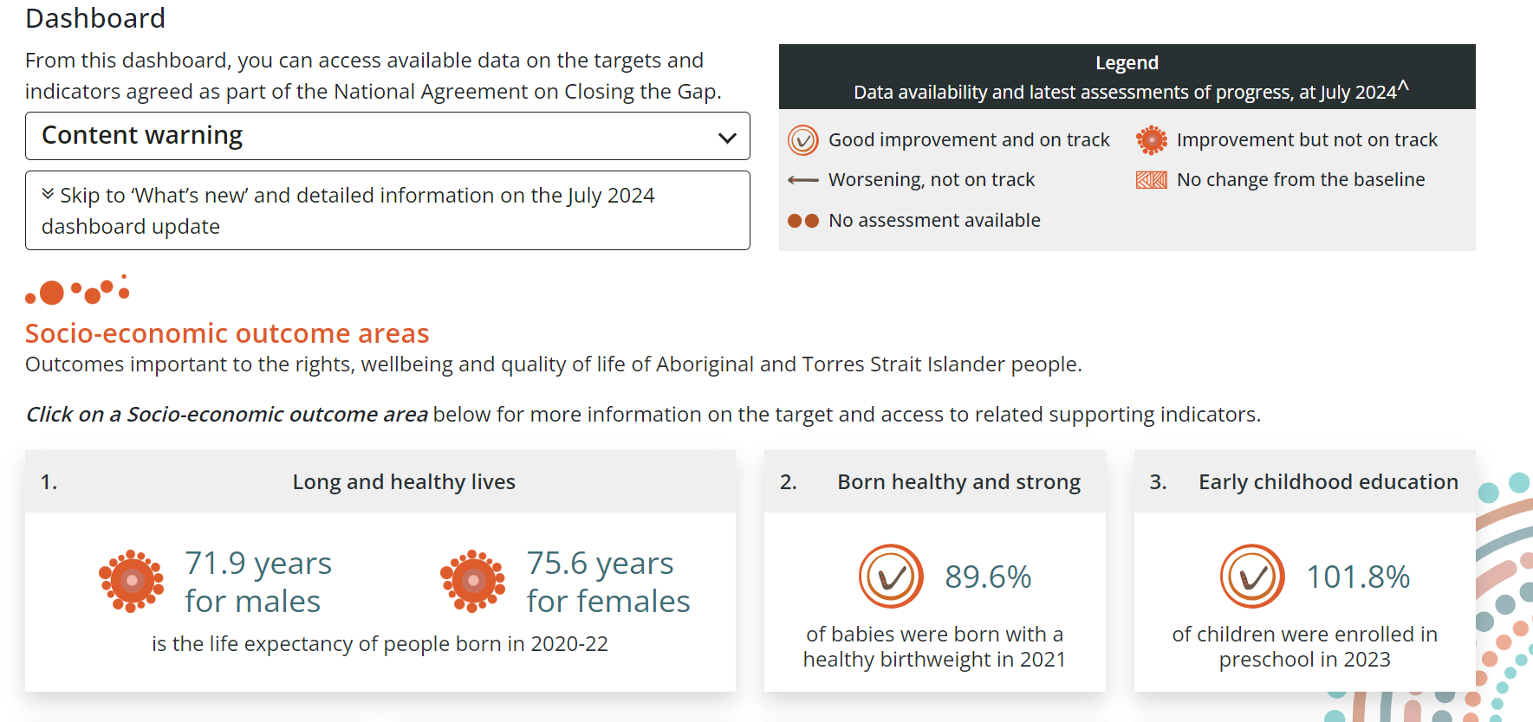
Developments in the July dashboard update
The dashboard contains context
for 8 socio-economic targets:
  Life Expectancy
  Healthy babies
  Early childhood education
  Adult incarceration
  Youth justice
  Child protection
  Social and emotional wellbeing
  Land and Waters

Slide 7
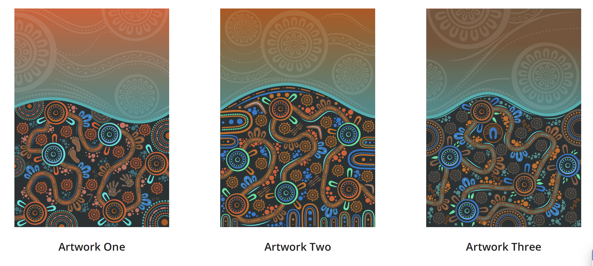
New artwork
Pathways of Progress:
A Journey Towards Closing the Gap
Artist: Lani Balzan
aboriginalartbylani.com.au

Slide 8



Progress and setbacks
Of the fifteen socio-economic targets with data available to assess progress
  5 targets show good improvement and are on track
  5 targets show improvement but are not on track
  1 target has no change from the baseline
  4 targets are worsening
  4 targets cannot be assessed

Slide 9
Outcomes by theme
Health, Wellbeing and development
CtG1:
71.9 years for males | 75.6 years for females
is the life expectancy of people born in 2020–2022
CtG2:
89.6%
of babies were born with a healthy birthweight in 2021
CtG14:
29.9 per 100,000
deaths due to
suicide in 2022
CtG4:
34.3%
of children commencing school were developmentally on track in 2021
Families and kin
CtG12:
57.2 per 1,000
children were in
out-of-home care in 2023
CtG13:
No new data since baseline for family violence
Education and training
CtG3:
101.8%
Of children were enrolled in preschool in 2023
CtG5:
68.1%
of 20–24 year olds with year 12 or equivalent in 2021
CtG6:
47.0%
of 25–34 year olds with certificate III or above in 2021
CtG7:
58.0%
of 15–24 year olds
fully engaged in employment, education or training in 2021

Slide 10
Outcomes by theme (2)
Housing
Employment
CtG9A:
81.4%
lived in appropriately sized housing in 2021
CtG9B:
No data available
for communities receive essential services
CtG8:
55.7%
of 25–64 year olds were employed in 2021
Justice
Language
CtG10:
2222.7 per 100,000
adults in prison in 2021
CtG11:
29.8 per 10,000
young people were in detention
CtG16:
No new data since baseline
were subject to Aboriginal and Torres Strait Islander peoples rights or interests in 2021
Digital
Inclusion
Country
CtG17:
No new data since baseline
CtG15A:
4 213 978 km²
of land
CtG15B:
113 461 km² of
sea country

Slide 11
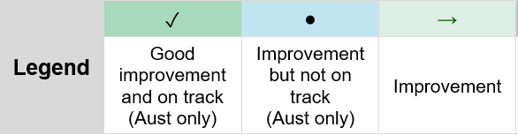
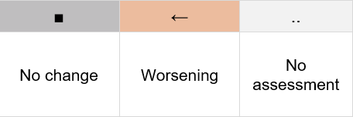
Summary of progress for states and
territories

Slide 12
Looking below the aggregate
Outcomes are not the same for all Aboriginal and Torres Strait Islander people:
Poorer outcomes for people living in more remote areas
Some improvement across all socio-economic areas of disadvantage.
Mixed outcomes for young people
Different outcomes for men and women
Some improvement for people living with a disability

Slide 13
Supporting indicators fill some of the picture
10 New Supporting Indicators
health risk factors
smoking during pregnancy
NAPLAN proficiency levels
social housing
prisoner health
young people first contact
with youth justice
child placement principles (ATSICPP)
family violence hospitalisations
experience of racism
digital inclusion

Slide 14
… but the picture is incomplete
We take an iterative approach to developing the dashboard
Currently report on 31 out of 164 supporting indicators (10 new in the July update)
Significant data development task

Slide 15
Understanding the data landscape
Annual reporting
2. Healthy birthweight
3. Preschool enrolment
10. Adult incarceration
11. Youth Justice
12. Out of home care
14. Suicide
15A. Land
15B. Waters
3 yearly reporting
4. Early child development
Periodic
16. Language
5 yearly reporting
1. Life expectancy
5. Education
6. Youth engagement
7. Higher education
8. Employment
9A. Housing
Reporting tbc or not commenced
9B. Access to Services
(community infrastructure)
13. Safe Families
17. Digital Inclusion

Slide 16
No data on the Priority Reforms
Priority Reform 1
Formal partnerships and shared decision-making
Priority Reform 2
Building the
community-controlled sector
Priority Reform 3
Transforming government organisations
Priority Reform 4
Shared access to
data and information
at a regional level

Slide 17
A demonstration of the dashboard and ADCR
Dashboard | Closing the Gap Information Repository - Productivity Commission (pc.gov.au)

Slide 18
The data shows the need for full implementation of the National Agreement
Earlier this year, the Productivity Commission released the first comprehensive three-yearly Review of the National Agreement.
Joint Council has accepted the four headline recommendations:
  governments need to share power to make meaningful progress
  Indigenous Data Sovereignty must be recognised and supported
  mainstream systems and culture within governments should be fundamentally rethought
  stronger accountability is required to drive behaviour change
15 out of the 16 actions under the recommendations have been accepted.

Slide 19
Thank you
Thanks to our participants for their support in reviewing and commenting on the draft dashboard and ADCR.
Further queries?
Please contact us ctg.data@pc.gov.au
pc.gov.au/closing-the-gap-data

Slide 20
A dive into a selection of targets

Slide 21

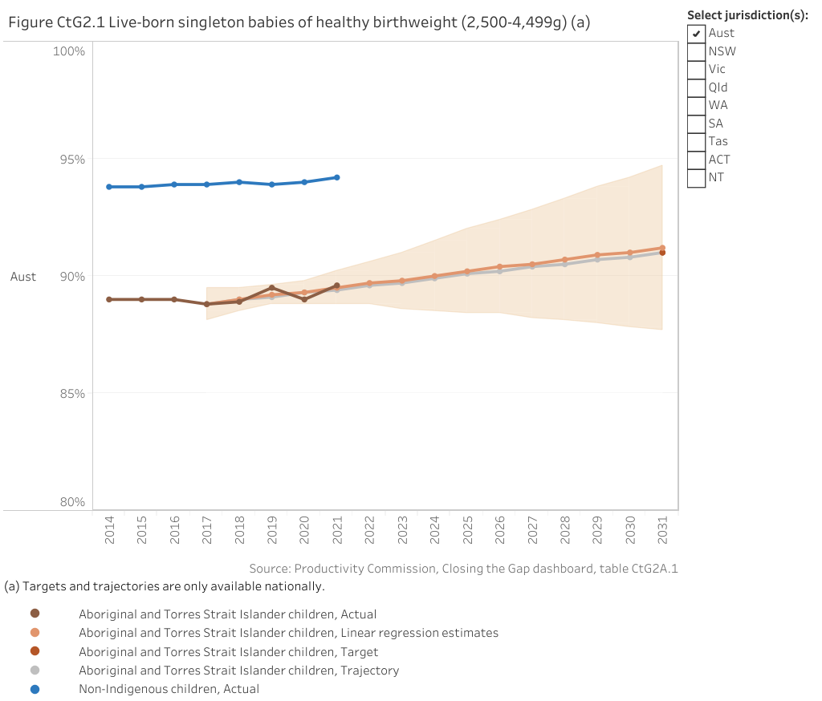
Outcome 2: Nationally, based on progress from the baseline, the Target shows good improvement and is on track to be met
Figure Live-born singleton babies of healthy birthweight (2,500-4,499g)
Nationally in 2021, 89.6% of Aboriginal and Torres Strait Islander babies born were of a healthy birthweight (figure CtG2.1).
This is an increase from 88.8% in 2017 (the baseline year).

Slide 22
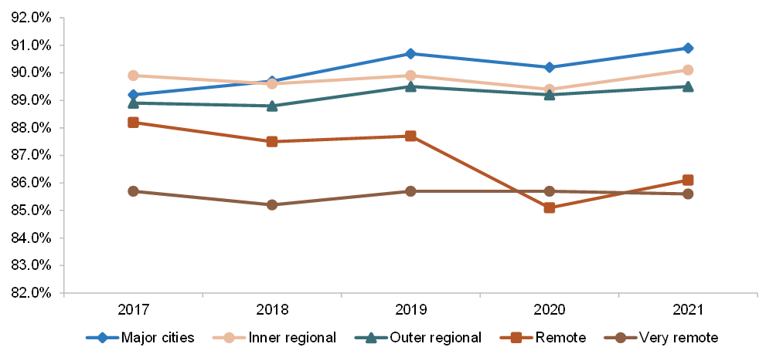
Outcome 2: Babies born of a healthy birthweight was lower in more remote areas
Live-born singleton babies of healthy birthweight (2,500-4,499g), by remoteness
Remote and very remote areas

Slide 23
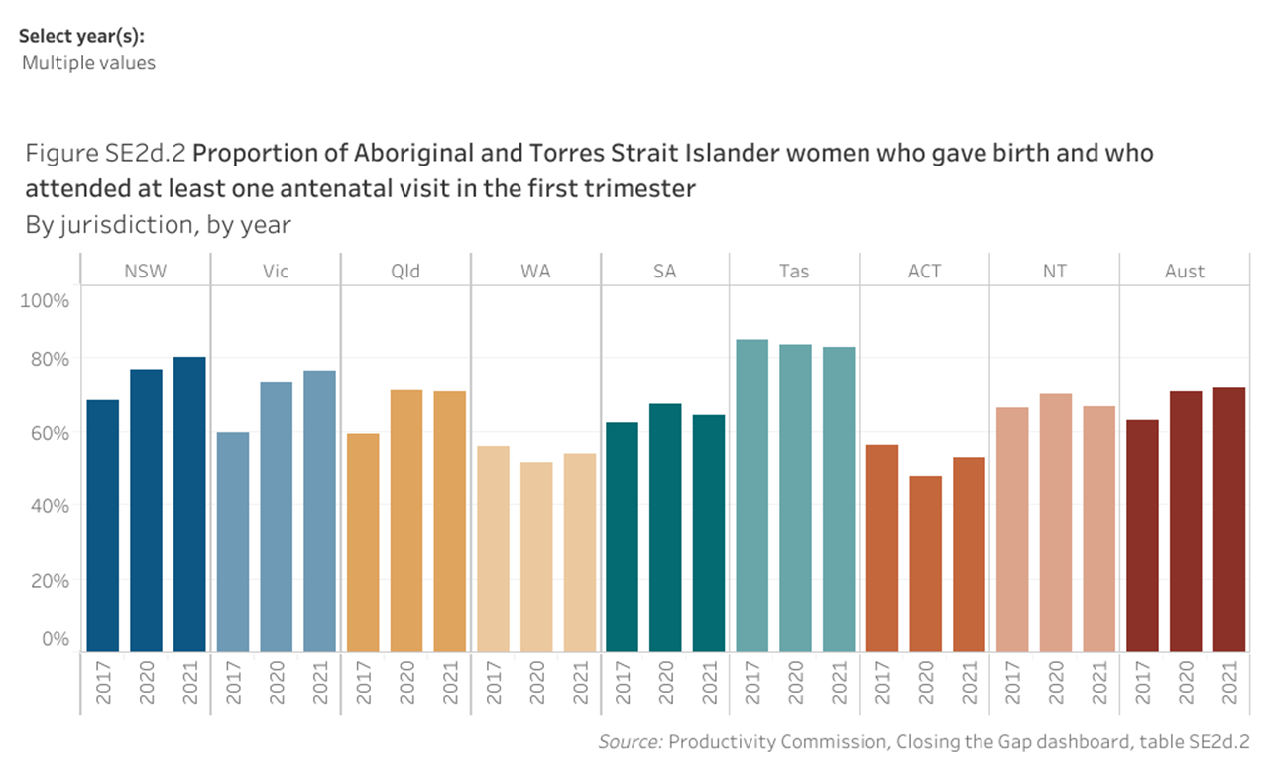


Outcome 2: There are rising rates of early antenatal care and falling smoking rates during pregnancy
Women with at least one antenatal care visit in the first trimester
Women with five or more antenatal care visits during pregnancy

Slide 24

Outcome 11: Nationally, the Target shows no change from the baseline and is not on track to be met
Rate of Aboriginal and Torres Strait Islander young people in detention on an average day per 10,000 young people (aged 10–17 years)

Slide 25
Outcome 11: There are differing trends across jurisdictions
Young people in detention on an average day, Rate per 10,000 young people

Slide 26
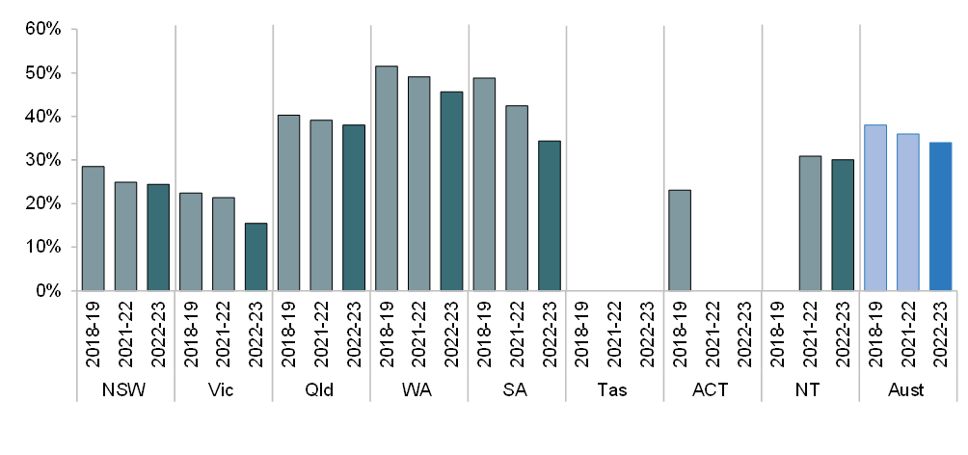
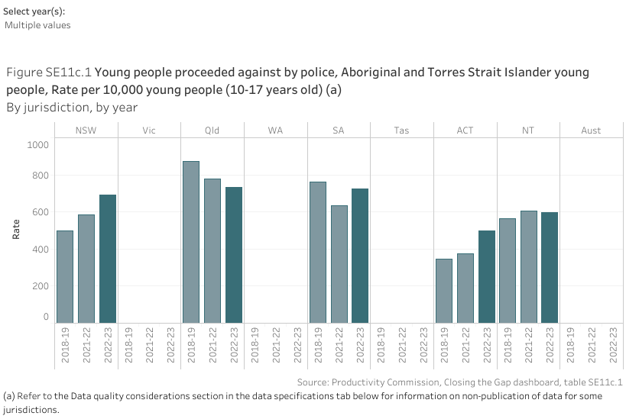
Outcome 11: Young people are entering the youth justice system at older ages
Aboriginal and Torres Strait Islander young people under youth justice supervision – aged 10–13 years at first supervision
Young people proceeded against by police, Aboriginal and Torres Strait Islander young people, Rate per 10,000 young people (10-17 years old)

