Slide 1

Closing the Gap
Information Repository
July 2025 Dashboard update
2025 Annual Data Compilation Report
Public Webinar
Selwyn Button, Commissioner
Sarah Leary, Assistant Commissioner

Slide 2

Acknowledgement of Country

Slide 3
Presentation outline
Our role
2025 ADCR & July dashboard updates
Overview of progress
Considering context
Dashboard demonstration
Future considerations

Slide 4
Our role

Slide 5
The Commission has important accountability roles under the National Agreement
PUBLIC ACCOUNTABILITY FRAMEWORK (SECTION 9)
Dashboard
Jurisdictions Annual Report
Productivity Commission Review
Annual Data Compilation Report
Response by
Joint Council
Coalition of Peaks Report
Aboriginal and Torres Strait Islander led Review

Slide 6
2025 ADCR and July dashboard updates

Slide 7

2025 ADCR
Fifth report in the series
Thematic and strengths-based reporting
Analysis that looks beyond the headlines
More on the data landscape
State and territory progress
Snapshots of themes
Update on Closing the Gap Reviews
Priority Reform milestone

Slide 8

Indigenous story-telling through the data
  When it comes to the histories of Aboriginal and Torres Strait Islander people, it is data that tells our stories on a grand scale. Each statistic or number in a data report can be traced back to a person – an individual star – who happened to be asked or chose to share their story with others.
  Dr Scott Avery

Slide 9
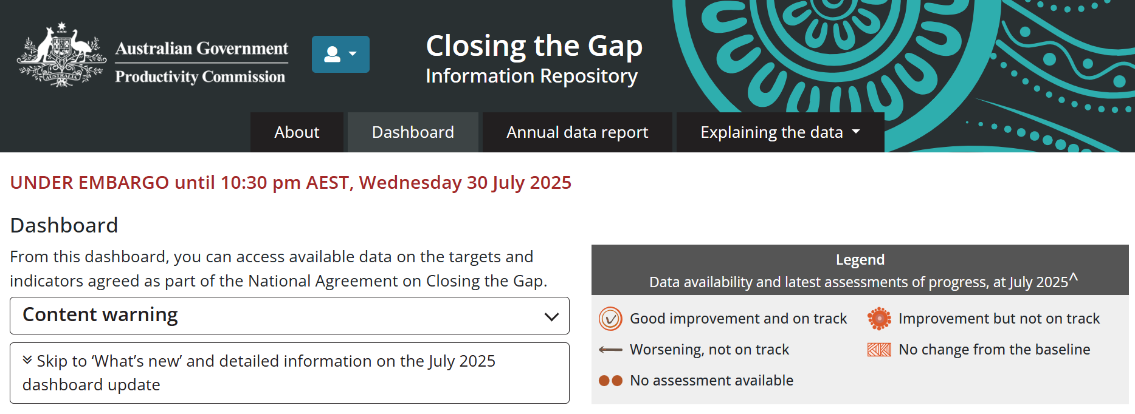
The July 2025 dashboard includes new updates
Historical and ongoing context
target 8: economic participation
Revised population rates:
target 3: preschool enrolment
A new year of data:
target 3: preschool enrolment
target 4: early child development
New disaggregations for:
target 17: digital inclusion
New material:
12 new supporting indicators

Slide 10
Overview of progress

Slide 11




The information repository continues to report mixed progress
Fifteen socio-economic targets with data available to assess progress
  4 targets show good improvement and are on track
  6 targets show improvement but are not on track
  1 target has no change from the baseline
  4 targets are worsening
  4 targets cannot be assessed

Slide 12
Outcomes vary by theme
Health, Wellbeing and development
CtG1:
71.9 years for males | 75.6 years for females
is the life expectancy of people born in 2020–2022
CtG2:
89.2%
of babies were born with a healthy birthweight in 2022
CtG14:
30.8 per 100,000
deaths due to
suicide in 2023
CtG4:
33.9%
of children commencing school were developmentally on track in 2024
Families and kin
CtG12:
50.3 per 1,000
children were in
out-of-home care in 2024
CtG13:
8.4%
of females experienced harm
No new data since baseline
Education and training
CtG3:
94.2%
Of children were enrolled in preschool in 2024
CtG5:
68.1%
of 20–24 year olds with year 12 or equivalent in 2021
CtG6:
47.0%
of 25–34 year olds with certificate III or above in 2021
CtG7:
58.0%
of 15–24 year olds
fully engaged in employment, education or training in 2021

Slide 13
Outcomes vary by theme (2)
Economic participation
Housing
CtG9A:
81.4%
lived in appropriately sized housing in 2021
CtG9B:
No data available
CtG8:
55.7%
of 25–64 year olds were employed in 2021
Digital
Inclusion
Justice
CtG11:
26.1 per 10,000
young people were in detention in 2023-24
CtG17:
88.3%
accessed the internet in 2022-23
No assessment of progress
CtG10:
2304.4 per 100,000
adults in prison in 2024
Culture and Language
Country
were subject to Aboriginal and Torres Strait Islander peoples rights or interests in 2024
CtG16:
123
languages spoken
No new data since baseline
CtG15A:
4 314 744 km²
of land
CtG15B:
113 517 km² of
sea country

Slide 14
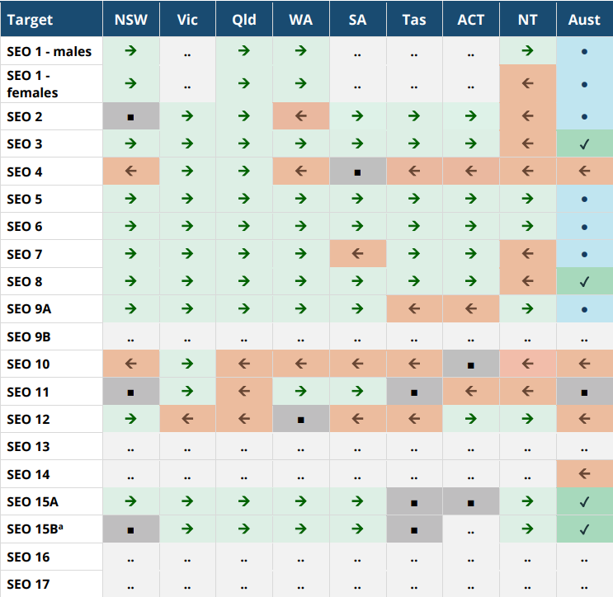



Improvement for many States and Territories for most targets*
* There are no State and Territory targets established in the National Agreement
The table highlights areas where jurisdictions have shown:
improvement
worsening
no change

Slide 15
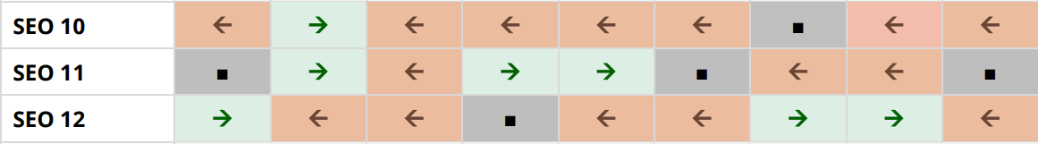
Although outcomes against the adult imprisonment, youth justice and out-of-home care are of concern

Slide 16
Considering context

Slide 17
Outcomes are not the same for all Aboriginal and Torres Strait Islander people
Poorer outcomes for people living in more remote areas
Some improvement across all socio-economic areas of disadvantage
Mixed outcomes for young people
Different outcomes for men and women
Some improvement for people living with a disability

Slide 18
Analysis of the supporting indicators in the ADCR help to understand the drivers for change and context to the outcomes
Introduced to reporting in 2025
Supporting indicators (drivers)
  Potentially avoidable mortality
  School attendance
  Caring responsibilities
  Prisoner legal status
  Unsentenced detention
  Self-harm hospitalisations
  Aboriginal and Torres Strait Islander language speakers
  Employed in media
Supporting indicators (contextual)
  VET graduate outcomes
  Prisoner legal status
  OOHC Cultural support plans
  SHS assistance (with children)
  Connection to homelands

Slide 19
Beyond the headline - considering context
Historical and ongoing context
Cultural and historical context included for socio-economic outcome area 8 (economic participation)
  Economic activity can be in many forms
  Has existed for tens of thousands of years
  Provides independence and autonomy

Slide 20
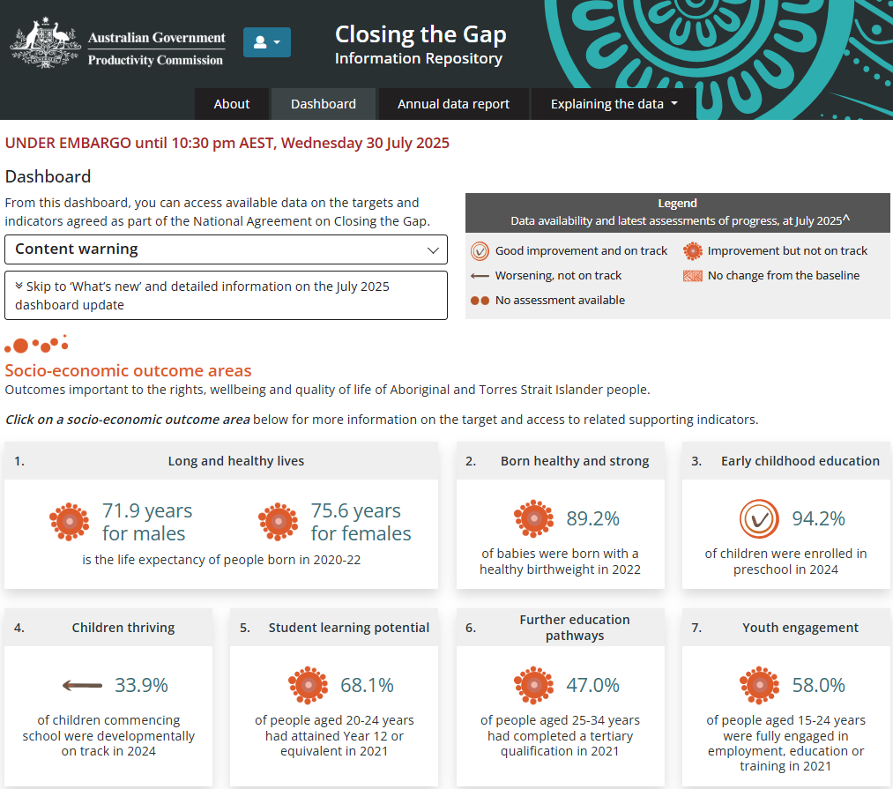
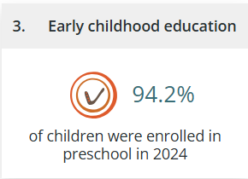
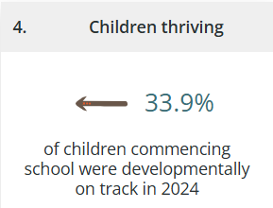
What are the outcomes for Aboriginal and Torres Strait Islander young children?
Dashboard | Closing the Gap Information Repository - Productivity Commission (pc.gov.au)

Slide 21
Future considerations

Slide 22
The work is ongoing to report all the data specified in the Agreement for the CtG information repository
There is no data to assess progress on the Priority Reforms
We do not have an assessment of progress for four socio-economic targets
Many targets have only been assessed once
The dashboard reports on 54 of the 164 supporting indicators
150 data development items
2026 reporting - targets and supporting indicators
with annual data

Slide 23
The outcomes reported highlight the ongoing need for the implementation of the National Agreement
Independent Aboriginal and Torres Strait Islander-led review
  12 Key Findings
  9 Recommendations
The PC will release case studies of transformative action aligned with Priority Reform 3 starting in September
Terms of reference for the second
PC review are expected by early 2026

Slide 24
Thank you
Thanks to our participants for their support in reviewing and engaging in the drafting of the dashboard and population rates transition.
Further queries?
Please contact us ctg.data@pc.gov.au
pc.gov.au/closing-the-gap-data

