Slide 1

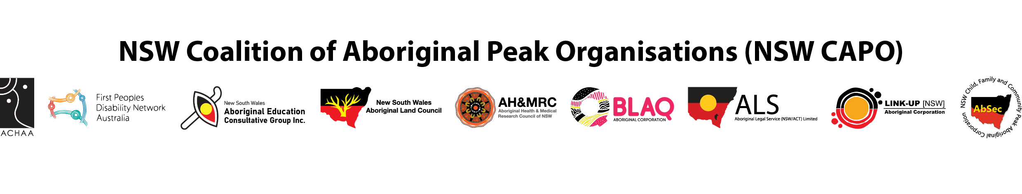
PR3 – Government Accountability Mechanism

Slide 2
Acknowledgement of Country
NSW CAPO acknowledges the Traditional Owners of the land where we work and live. We pay respect to Elders past and present and extend that respect to all Aboriginal People.

Slide 3
Priority Reform Three:
Transforming Government Organisations
Government organisations and services are culturally safe.
Government organisations and services are accountable to Closing the Gap.
Government orgs & services are responsive to the needs of Aboriginal people.

Slide 4
NSW
DESIGN AN INDEPENDENT, ABORIGINAL-LED ACCOUNTABILITY MECHANISM TO MONITOR GOVERNMENT ACCOUNTABILITY:
• By 2024, we will develop a pilot design for an Aboriginal-led accountability mechanism to monitor the alignment of government policies on Closing the Gap. This will be based on foundational work and research on the best model and design for this accountability mechanism.
o The accountability mechanism will include at least two core aspects:
▪ establishment of core criteria to monitor, improve and evaluate the alignment of government policies and programs with the Closing the Gap commitments to transform government organisations and services*
▪ establishment of an independent Aboriginal accountability authority.
o Following the design phase, there will be a trial period and then implementation of the mechanism.*

Slide 5
National
PARTNERSHIP ACTIONS
By 2023, Government Parties agree to each identify, develop or strengthen an independent mechanism, or mechanisms, that will support, monitor, and report on the transformation of mainstream agencies and institutions. The mechanism, or mechanisms, will:
  support mainstream agencies and institutions to embed transformation elements, as outlined in Clause 59, and monitoring their progress
  be recognisable for Aboriginal and Torres Strait Islander people and be culturally safe
  engage with Aboriginal and Torres Strait Islander people to listen and to respond to concerns about mainstream institutions and agencies
  report publicly on the transformation of mainstream agencies and institutions, including progress, barriers and solutions.

Slide 6

Project Approach
Stakeholder engagement with Aboriginal community; Aboriginal sector; Government, accountability bodies; experts.
Phase 1 – broad questions (August – November)
Deliberative Forum (October)
Phase 2 – Models for feedback (January – April)
Research
Scan of bodies (complete)
Scan of approaches (underway)
Literature scan (early next year)
Final report (April – June)

Slide 7
JURISDICTIONAL SCAN
  SUCCESS OF BODIES
  The success of an accountability body is rooted in its power to bring about change.
  Hard power – consequences.
  Soft power – independence.
  BODIES TO LEARN FROM
  Commonwealth Productivity Commission
  ATSIEB
  BODIES TO CONSIDER AS MECHANISM
  No existing accountability bodies in NSW fully meet the needs of the Mechanism.
  Could reform:
  Deputy Ombudsman for Aboriginal Programs,
  NSW Auditor-General
  Dependent on perception by Aboriginal community.

Slide 8
PHASE ONE COMMUNITY CONSULTS
  So far we’ve held workshops in:
  Batemans Bay Bourke
  Broken Hill Dubbo
  Liverpool Moree
  Newcastle Orange
  Redfern Albury
  Grafton
  Still to come:
  Coonabarabran Tamworth
  Kempsey Wyong

Slide 9
FUNCTIONS:
Hold organisations and individuals to account for ineffective performance and bad faith actions.
Measure and communicate outcomes in a way that is meaningful for community.
Reporting progress against local needs
Transparency around funding.
Truth test & verify reporting and measurement
FEATURES:
Recognisable – well branded and publicised.
Local, regional and state.
Mob in leadership positions, minimum CEO & board.
Trauma informed
Plain English
Adequately and sustainably funded
Lore is centred
Legislated to have real teeth
No lateral violence
Outreach to young people

Slide 10
LEVERS:
Individual accountability, including for high-ranking people.
Sliding scale of consequences
  Good consequences – recognition, promotion, incentives, awards.
  Minor infractions – tailored support, find solutions together.
  More serious – cut funding, re-direct funding, financial penalty, demoted, performance review, no bonus, reduction in power, contract breach.
Build positive relationships and solutions together - government is a system made up of people.
FEEDBACK ON DEP OMB & AUDITOR GENERAL
When has Ombudsman ever come out to community?
They have the title and the wages, but not the power and influence.
Some would trust these with more power (proof in the pudding), some wouldn’t (scary)
Ombudsman seen as government.
COMMON IDEAS
Black ICAC
Link to UN
Work with Empowered Communities and Regional Alliances.
Momentum, community and class action builds systemic change.
Score cards
Annual yarn up

Slide 11
Building support- leading from the front

Slide 12
PRODUCTIVITY COMMISSION REVIEW
Stronger accountability mechanisms are needed to drive change
Existing [accountability] mechanisms lack ‘bite’ – they are not sufficiently independent, do not contain timely and appropriate consequences for failure, obscure the individual responsibilities of each party and are not informed by high-quality evaluation
The independent mechanism may be positioned to shine a spotlight on good and bad practices under the Agreement and advocate for improved policies, programs and services affecting Aboriginal and Torres Strait Islander people, though its role may need to expand beyond Priority Reform 3 to include the Agreement in its entirety
[Governments] need to establish stronger mechanisms so that [the public service is] held accountable for making changes from within. It is not acceptable for government employees to treat adhering to the principles of the Agreement as optional – these principles reflect essential capabilities and behaviours without which governments cannot hope to deliver on their Closing the Gap commitments.

Slide 13





Feedback
TODAY AT THE FORUM
BY EMAIL
ctgprojects@alc.org.au
BY PHONE
If you wish to discuss the project, please contact Iona on 02 9689 4467

Slide 14

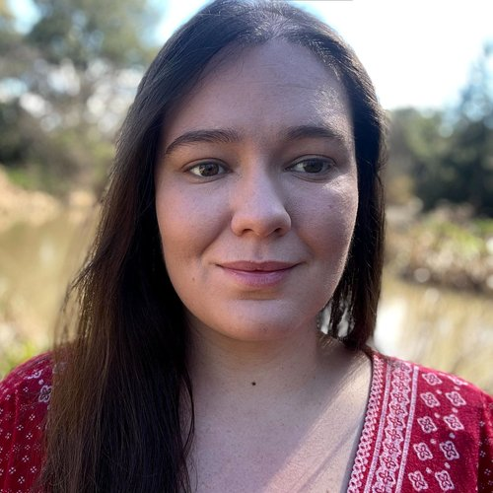
Stronger with Country
Our path to protecting Country has been paved by the work of our Land Rights Warriors that have come before us and is a journey that requires resilience and healing. Control and ownership of our country empowers our communities and supports our growth; as we protect our Country our Country supports us as it has for our ancestors.
The persistence that our mob have had to provide to move forward is immense. There is no underestimating how much strength is required to overcome the unrelenting barriers we face. Despite these challenges, we move forward, as individuals and as groups.
This artwork is for those that put in the work to provide for and nourish our land, culture and communities.
Monique is a proud Kamilaroi woman, who is passionate about using her design skills to support and empower other First Nations Australians and their businesses. Wearing her values on her sleeve to strive together toward an equitable future for First Nations Australians and for the protection of Country.
Monique Rennie
Created on Country

