Slide 1

The economics and the politics of productivity
Deloitte
Access Economics
Chris Richardson
13 December 2016

Slide 2
The big picture: World income shares

Slide 3
China is only part way through a tricky transition
Investment spending as a share of 170 different economies

Slide 4
Real living standards per head have stalled

Slide 5
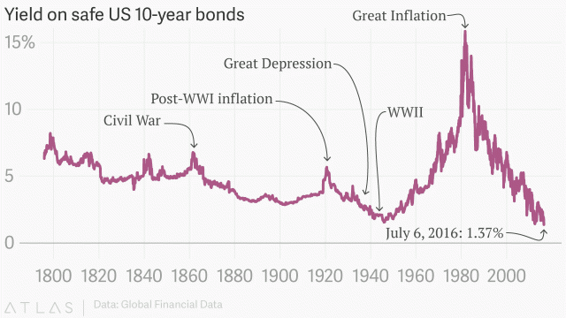
Interest rates are a long way from ‘home’

Slide 6
And ageing is an issue

Slide 7
So Australia’s need for reform has risen
We can’t simply slipstream China, and hope that prosperity will once again drop into our lap.
We can’t cut interest rates further, and use house prices as a prop to prosperity.
And nor will demographics help to turn the corner for us. In fact they’ll work the other way.

Slide 8
But our ability to reform has fallen
Yet although the demand for reform has risen, the ‘supply’ of it coming out of our political processes has fallen:
That’s no coincidence – when the pie is shrinking, then the task of the politicians is harder. The siren song of the populists falls on more fertile ground.
Besides, we’ve already picked a bunch of the low hanging fruit – you can only float the dollar once.
Worse still, the growing competition in the market for votes has rained on the productivity parade – the behavior of both sides while in Opposition has worsened. The result is that it is getting easier to become Prime Minister, but harder to do anything once you’ve done so.

Slide 9
I’m looking at the man in the mirror:
I’m hoping he will change his ways
So the politics of productivity have become diabolical. And that’s a structural shift. I don’t think a recession would shake Australia out of complacency and into action. So what can we economists do?
We can accentuate the positive: we agree on lots, and yet we tend to concentrate on our disagreements (and the media tends to report those disagreements rather than our areas of broad agreement).
We can be Bernie, not John: and accept partial progress.
We can help to hold Oppositions (of all political stripes) to the same standard that we do Governments. Any given reform is just three banner headlines away from being buried. Let’s help avoid them.

Slide 10





Limitations of our Work
General Use Restriction
Guidance Note: tailor the wording as appropriate depending on your Service Line’s requirements.
This report is prepared solely for the internal use of [include client]. This report is not intended to and should not be used or relied upon by anyone else and we accept no duty of care to any other person or entity. The report has been prepared for the purpose set out in our [engagement letter / contract] dated [day month year] [or set out purpose here]. You should not refer to or use our name or the advice for any other purpose.
General information only
This presentation contains general information only, and none of Deloitte Touche Tohmatsu Limited, its member firms, or their related entities (collectively the “Deloitte Network”) is, by means of this presentation, rendering professional advice or services. Before making any decision or taking any action that may affect your finances or your business, you should consult a qualified professional adviser. No entity in the Deloitte Network shall be responsible for any loss whatsoever sustained by any person who relies on this presentation.
About Deloitte
Deloitte refers to one or more of Deloitte Touche Tohmatsu Limited, a UK private company limited by guarantee, and its network of member firms, each of which is a legally separate and independent entity. Please see www.deloitte.com/au/about for a detailed description of the legal structure of Deloitte Touche Tohmatsu Limited and its member firms.
Deloitte provides audit, tax, consulting, and financial advisory services to public and private clients spanning multiple industries. With a globally connected network of member firms in more than 150 countries, Deloitte brings world-class capabilities and high-quality service to clients, delivering the insights they need to address their most complex business challenges. Deloitte has in the region of 225,000 professionals, all committed to becoming the standard of excellence.
About Deloitte Australia
In Australia, the member firm is the Australian partnership of Deloitte Touche Tohmatsu. As one of Australia’s leading professional services firms. Deloitte Touche Tohmatsu and its affiliates provide audit, tax, consulting, and financial advisory services through approximately 6,000 people across the country. Focused on the creation of value and growth, and known as an employer of choice for innovative human resources programs, we are dedicated to helping our clients and our people excel. For more information, please visit our web site at www.deloitte.com.au.
Liability limited by a scheme approved under Professional Standards Legislation.
Member of Deloitte Touche Tohmatsu Limited
General information only
This presentation is for internal distribution and use only among personnel of Deloitte Touche Tohmatsu Limited, its member firms, and its and their affiliates. None of Deloitte Touche Tohmatsu Limited, Deloitte Global Services Limited, Deloitte Global Services Holdings Limited, the Deloitte Touche Tohmatsu Verein, any of their member firms or any of the foregoing’s affiliates shall be responsible for any loss whatsoever sustained by any person who relies on this presentation.
Deloitte refers to one or more of Deloitte Touche Tohmatsu Limited, a UK private company limited by guarantee, and its network of member firms, each of which is a legally separate and independent entity. Please see www.deloitte.com/au/about for a detailed description of the legal structure of Deloitte Touche Tohmatsu Limited and its member firms.
Liability limited by a scheme approved under Professional Standards Legislation.
Member of Deloitte Touche Tohmatsu Limited
© 2016

