Slide 1
Digital Innovation & Prevention / Early Intervention
www.pwc.com.au
Presentation to the Productivity Commission
December 2016

Slide 2
Agenda
Digital innovation
Prevention & early intervention

Slide 3
Digital Innovation - Links
Digital Innovation
http://www.digitalinnovation.pwc.com.au/
Digital for Small and Medium Enterprises
http://www.digitalinnovation.pwc.com.au/small-business-digital-growth/
Digital for Government
http://www.digitalinnovation.pwc.com.au/digital-innovation-for-government/
Start Up Economy
https://www.digitalpulse.pwc.com.au/wp-content/uploads/2013/04/PwC-Google-The-startup-economy-2013.pdf

Slide 4
We are facing a technology change singularity
Historic point in the maturing of multiple technologies
Feeding into each other and combining with globalisation to accelerate change
The result will be a technology change singularity over the coming decades
Visible major disruptions already emerging – eg Amazon, Uber, Airbnb, etc
Emerging disruptions – eg banking, education, health
Government is not immune
Threats and opportunities for Australia

Slide 5
We need to focus as a nation on building our innovation eco-system
Venture Capital
Over the last 10 years, the US has spent $285b in VC versus $4.5b in Australia with key gaps across the ecosystem
Research & Development
Over 50% of Business R&D is concentrated in physical capital industries and we lag in our ability to commercialise
Education
STEM course completions have fallen from 22% to 16% (2002 to 2012) whilst our Asian neighbours increase (52% in Singapore 2012)

Slide 6
Digital Innovation benefits

Slide 7
Role for Government?
Be the creator of innovation opportunities
Shore the skill base
Incentivise innovation
Put digital and citizen first

Slide 8
Actions
SMEs
PwC estimates $49.2 billion of untapped economic potential (NPV, 10 years)
53% rural and regional
Digital Innovation
Government
- Actions to build innovation Ecosystem
Regulation
Design thinking NCP style review
More targeted that NCP

Slide 9
Agenda
Digital innovation
Prevention & early intervention

Slide 10
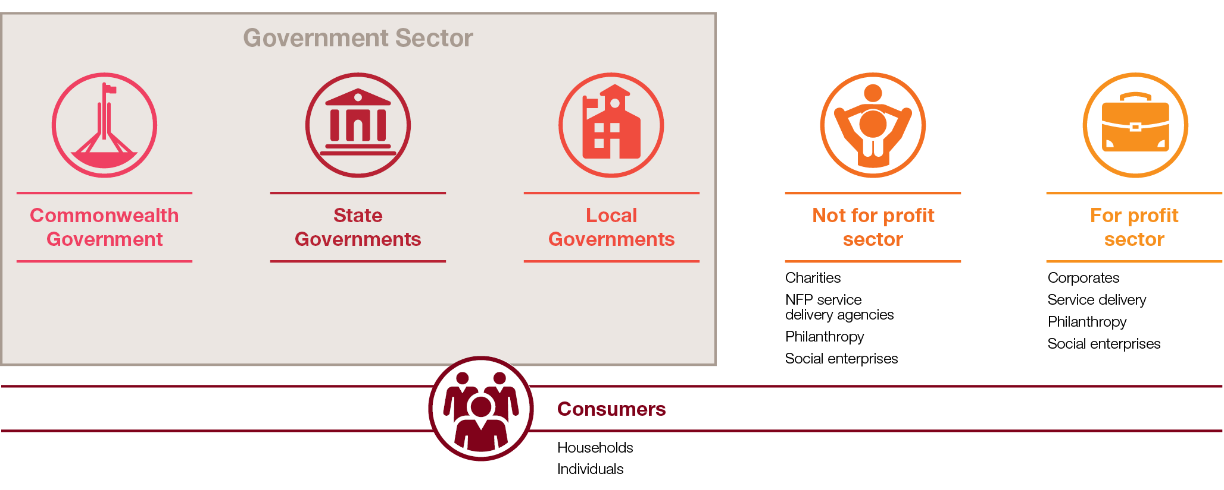
Australia’s social purpose market
In April 2016, PwC & the Centre for Social Impact launched a report on Australia’s social purpose market:
Over $510 bn is spent each year on health, education, social security & housing
Governments contribute 80% (55% by the Commonwealth)
7 key areas that can yield productivity gains emerged, including prevention / early intervention
Hypothesis: there is massive underinvestment in prevention & early intervention

Slide 11
Prevention / early intervention vs Acute
Victorian Royal Commission into Family Violence:
227 recommendations
3 ‘prevention’ category recommendations
South Australian Child Protection Systems Royal Commission:
260 recommendations
5 prevention / early intervention recommendations
Notes:
Recent examples of tension between prevention/early intervention vs acute = Royal commissions
VIC Royal Commission into Family Violence: 227 recs, 3 relating to prevention
Admittedly, recommends need for more prevention & developing strategies
SA Child Protection Systems Royal Commission: 260 recs, 5 relating to prevention and/or early intervention
Again, recommends need for more prevention/early intervention and directorate
Both highlight skewed funding flow/attention towards acute + need for more funding/attention towards prevention/early intervention, preferably to NGO sector

Slide 12
Political economy
Prevention & Early intervention
Primary – before there is a problem
Secondary – early warning signs
Tertiary – better managing chronic states
Reform narrative
Prevention is better than cure
Early childhood & children
Less institutional barriers
Economic case
Budget repair
Barriers
Longer term nature of benefits
$ away from frontline services
Lack of confidence in execution & delivery of benefits
Acute

Slide 13
Early childhood
Early childhood is an opportunity to influence health, education & employment outcomes later in life
PwC’s 2014 report demonstrated the potential benefits of quality education and care to the Australian economy:
Benefits of increased female workforce participation
Benefits for children receiving a quality education and care program
Benefits of increased participation of vulnerable children
$6.0 bn
cumulative to 2050, or
$3.7 bn
in NPV terms
Up to
$10.3 bn
cumulative to 2050, or
$3.0 bn
in NPV terms*
$13.3 bn
cumulative to 2050, or
$2.7 bn
in NPV terms

Slide 14
Obesity
Australian prevalence has increased 47% between 1995 and 2011-12
Associated risk factor for a range of diseases eg CVD, musculoskeletal disease, mental health issues, diabetes, cancer etc.
PwC report for Obesity Australia projected obesity would cost Australia $88 bn over 10 years
Suite of prevention & interventions has potential benefits of $2.1 bn over 10 years

Slide 15
Domestic violence
Half of all women experience violence, abuse or stalking from age 15+
PwC report estimated violence against women costs Australia $21.7 bn a year
Potential lifetime benefits of reducing violence against women:
>$35.6 m from community mobilisation programs
>$2.2 bn from individual & direct participation programs

Slide 16
Actions
Access
Early Childhood
- Finish the reforms COAG started
Quality
System Design
Place based
COAG Reform Package (or Sectoral?)
Tailored to each jurisdiction
Pooled funding / governance
Outcome focussed incentives
Transparent measurement
Agile implementation
Include place based
Health
Justice
Human Services

Slide 17
© 2016 PricewaterhouseCoopers. All rights reserved. PwC refers to the Australian member firm, and may sometimes refer to the PwC network. Each member firm is a separate legal entity. Please see www.pwc.com/structure for further details. Liability limited by a scheme approved under Professional Standards Legislation

