Slide 1

Reaping broader economic benefits from an effective healthcare system:
A visual lens
Presented by
Michael Brennan
Chair
Canberra Health Summit: 24 July 2019

Slide 2

1% of the NSW population account for 46% of hospital bed days
The cost of waiting - $900 million annually
75% of Australians over 75 years have inadequate health literacy
66% of obese Australians have no discussion with their GP about their weight
Take up of computers- 96% of GPs but 22% of surgeons

Slide 3
Economic impacts – the mechanisms
Healthcare system
Participation
Dynamic effects
Skill formation
Employment
Displaced resources
Hours worked
Innovation
Productivity
Incentive effects
GDP per capita

Slide 4
Australia gets fairly good outcomes for its spending
Source: http://stats.oecd.org/Index.aspx?DataSetCode=SHA

Slide 5
Australia’s principal health challenge is
managing chronic illness
Selected condition | Number of Australians 2017-18 | Share of Australian population
Diabetes | 1.2 million | 4.9%
Mental and behavioural problems | 4.8 million | 20.1%
Chronic obstructive pulmonary disease | 0.6 million | 2.5%
Heart, stroke and vascular disease | 1.2 million | 4.8%
Source: ABS, National Health Survey: First Results, 2017–18 — Australia, Cat. No. 4364

Slide 6
Time is not a great healer
Source: ABS, National Health Survey: First Results, 2017–18 — Australia, Cat. No. 4364

Slide 7
Ill-health is relatively enduring in Australia
Source: WHO data

Slide 8
The share of life spent in ill-health is rising
Source: WHO data

Slide 9
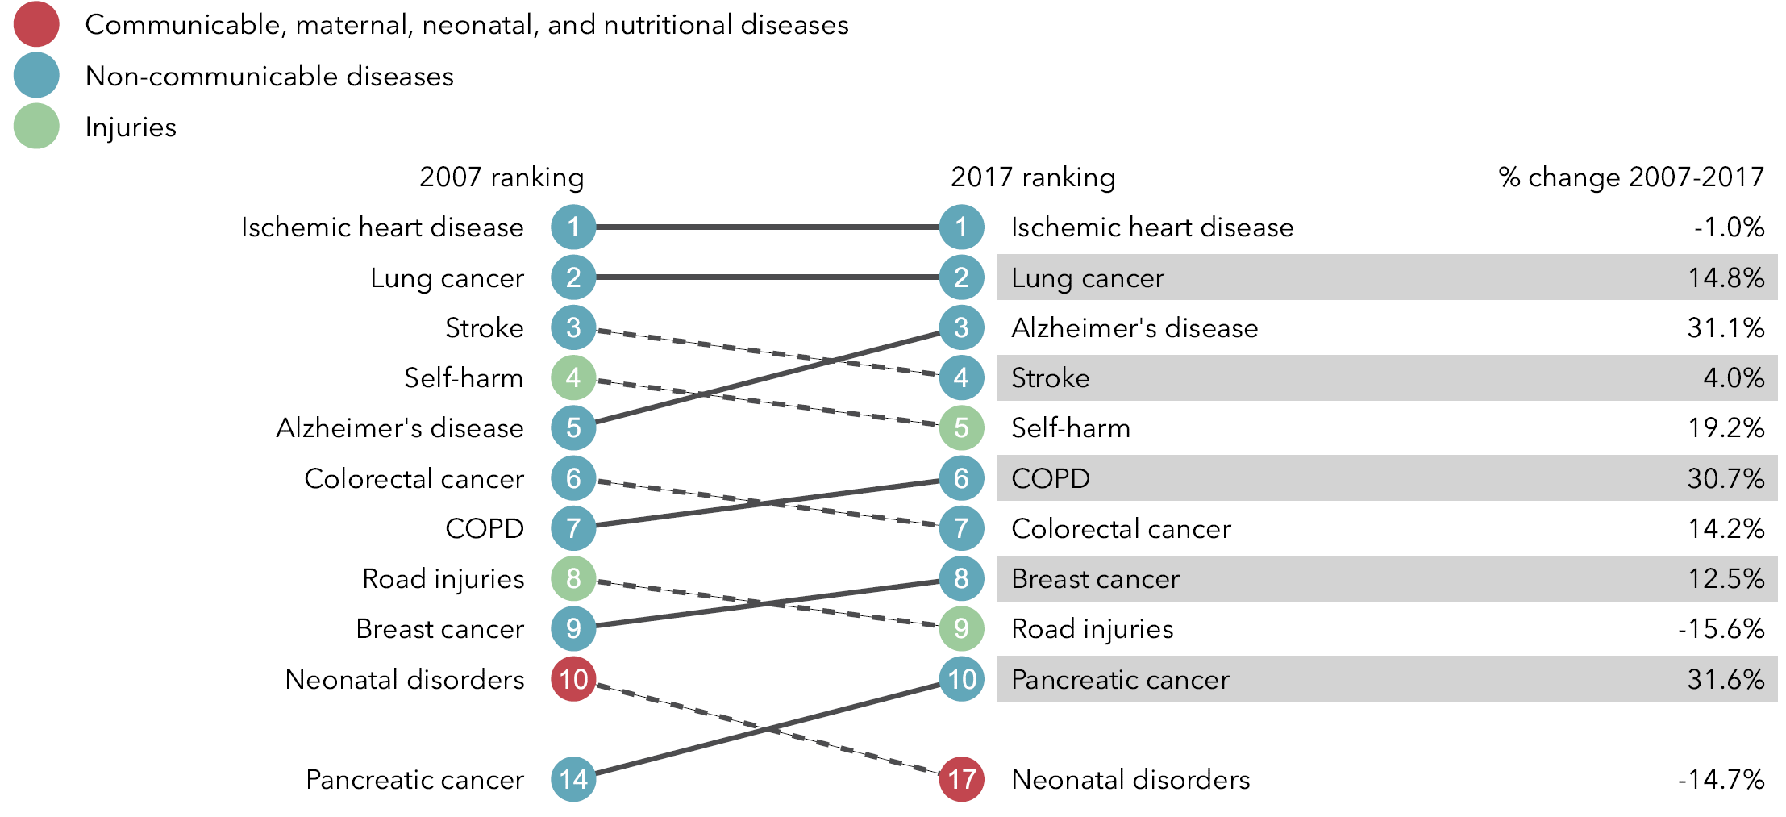
What causes the most premature death?
Source: www.healthdata.org/australia

Slide 10
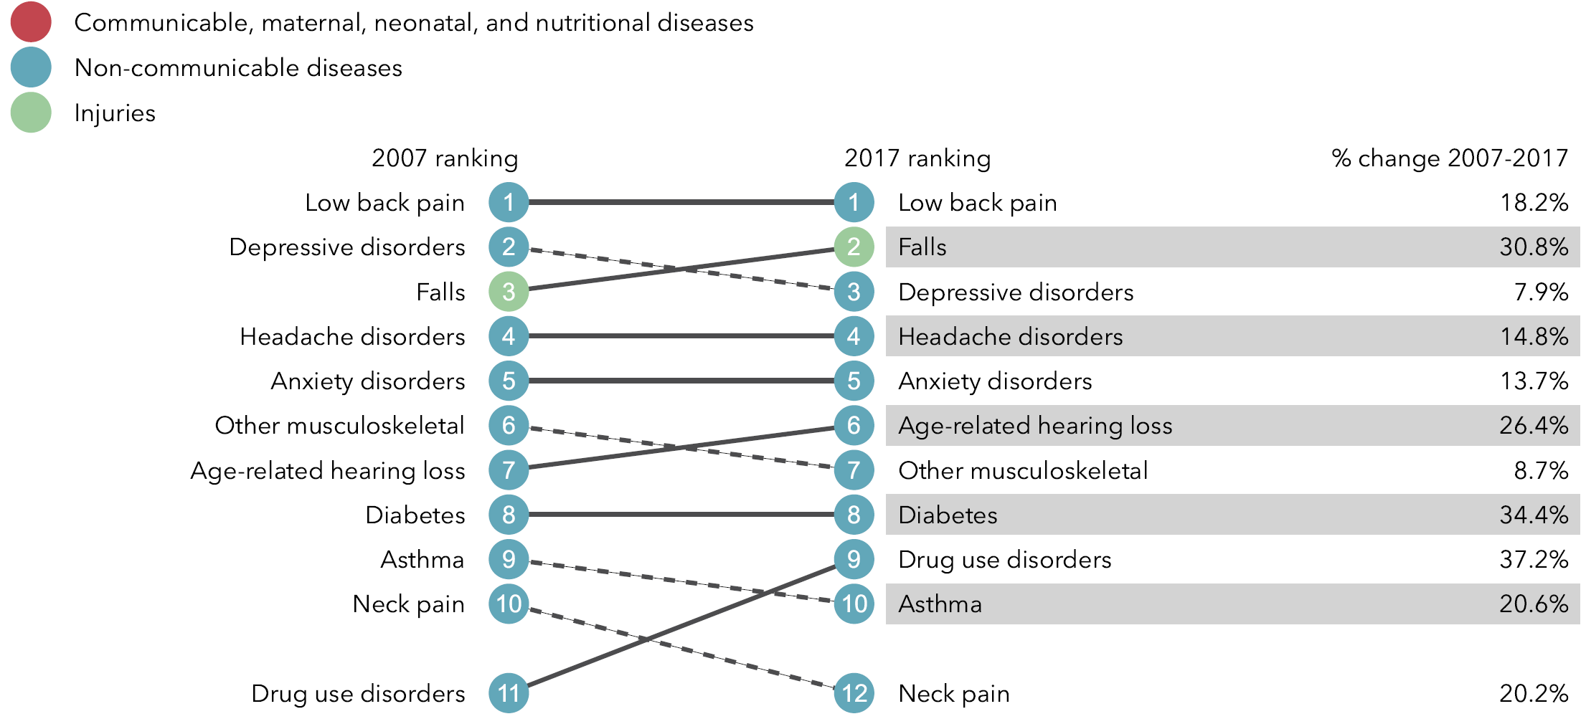
What causes the most disability?
Source: www.healthdata.org/australia

Slide 11
Poor health – lower participation and higher unemployment
Bad for labour force
participation
Bad for
unemployment
25-49 years old
50-69 years old
Source: ABS General Social Survey 2014

Slide 12
People in poorer health tend to work fewer hours
Source: ABS Survey of Disability and Carers, 1998-2015

Slide 13
The labour force participation ‘deficit’ of disease
25-54 yrs
55-64 yrs
Source: ABS, General Social Survey, June 2014, Tablebuilder data extraction

Slide 14
Disability also produces bad labour market outcomes
 | Participation rate | Unemployment rate
Profound/severe core activity limitation | 25.0 | 14.5
Moderate core activity limitation | 47.4 | 7.7
Mild core activity limitation | 58.9 | 8.3
Schooling/employment restriction | 45.0 | 12.1
No disability | 83.2 | 5.1
Source: ABS, Disability, Ageing and Carers, Australia: Summary of Findings, 2015, Cat. No. 4430 Table 20 (15-64 year olds)

Slide 15
Of those employed, disability reduces hours worked
Source: ABS, Disability, Ageing and Carers, Australia: Summary of Findings, 2015, Cat. No. 4430 Table 20, (15-64 year olds)

Slide 16
The impacts of psychological disability
Participation rates
Employment restriction and psychological disability
28.9%
Employment restriction and other disability
52.5%
83.2%
No reported disability
Source: ABS, Disability, Ageing and Carers, Australia: Summary of Findings, 2015, Cat. No. 4430 Table 20, (15-64 year olds)

Slide 17
Labour markets are increasingly unreceptive to disability
Not in the labour force
Unemployed
Relative risk of those
with cf those without a disability
Source: ABS Survey of Disability and Carers, 1998-2015

Slide 18
Other aspects of labour market experience are equally negative
Higher absenteeism - people with disabilities or long-term illnesses take 50% more sick days
People in very good health earn an hourly wage 18% higher than those in poor or fair health
46.3% of early retirements due to sickness/injury/disability and a further 8% due to caring
Poor health in the previous year increases retirement probabilities by 4.1% in the next year
People with poor mental health and disabilities much more likely to be on enduring welfare
Premature preventable death is the ultimate loss to an economy

Slide 19
Labour market outcomes for carers
Participation rate
Main source of income is social transfers
Primary carer
56.3%
42.7%
Not a carer
80.3%
11.3%
Source: ABS, Disability, Ageing and Carers, Australia: Summary of Findings, 2015, Cat. No. 4430 Table 40, 15-64 years

Slide 20
Indirect effects
Health spending in 2016-17 was $181 billion
Displaced resources
10.3% of GDP
Funding system does not encourage wellness
or sustaining work
Incentive effects
Financing budget creates its own resource costs (could be around 45 billion annually)

Slide 21
The scope for policy reform
Evidence-based technological developments in health produce dividends

Slide 22
Death and labour market activity are incompatible bedfellows, but there is good news …
The likelihood of dying for a 60 year old male in 2016 is the same as a 20 year old in 1886
Source: ABS Australian Historical Population Statistics, 2019, Cat. No. , 3105.0.65.001 (Mortality rate is Probability of dying between exact age x and exact age x+1 (qx), males, Australia, 1881 onwards)

Slide 23
The scope for policy reform
Evidence-based technological developments in health produce dividends
Preventative strategies have a lot of scope

Slide 24
Reduced smoking rates – a great success story
Source: https://data.oecd.org/healthrisk/daily-smokers.htm

Slide 25
Road fatality rates, 1925-2018
Source: BITRE

Slide 26
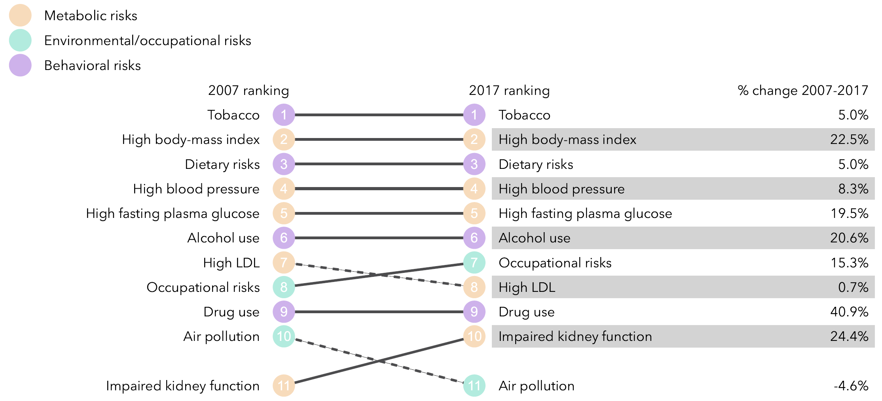
What risk factors drive the most death and disability combined?
Source: www.healthdata.org/australia

Slide 27
Country risk factors are clearly at work
Source: OECDStat 2019

Slide 28
Mental health concerns are rising
4.2 million people received mental health-related prescriptions in 2017-18
$9.1 billion was spent on mental health in 2016-17
260 000 overnight hospital separations in 2016-17
45% of Australians will have a common mental disorder in their lifetime
Source: AIHW 2019

Slide 29
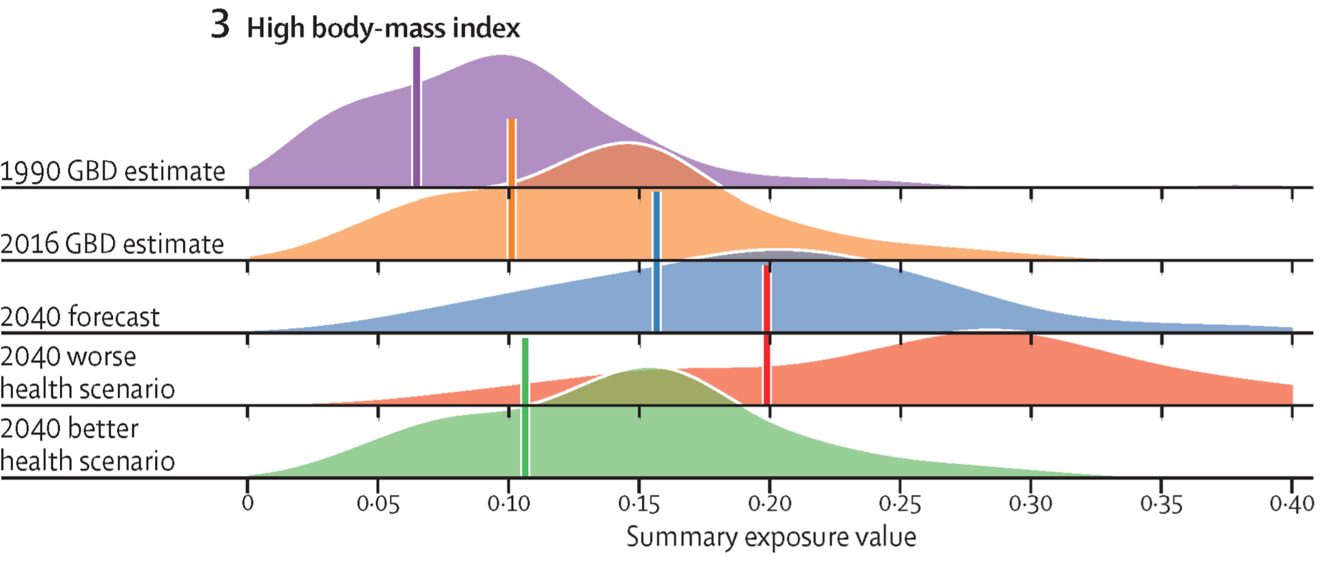
What goes up, can come down
Source: Foreman et al 2018, Forecasting life expectancy, years of life lost, and all-cause and cause-specific mortality for 250 causes of death: reference and alternative scenarios for 2016–40 for 195 countries and territories

Slide 30
Environmental risk drivers vary with income
Source: ABS, National Health Survey: First Results, 2017–18 — Australia, Cat. No. 4364,Table 6

Slide 31
The scope for policy reform
Evidence-based technological developments in health produce dividends
Preventative strategies have a lot of scope
Fill gaps in under-provision

Slide 32
The scope for policy reform
Evidence-based technological developments in health produce dividends
Preventative strategies have a lot of scope
Fill gaps in under-provision
A patient-centred integrated health system produces better outcomes inside and outside the healthcare system

Slide 33
The essential ingredients of integrated care …
Person-centred
Clinical mindsets
Health literacy
Knowledge
Self-management
Choice
Shared decisions

Slide 34

The essential ingredients of integrated care …
Seamless lifetime
care
Thick linkages (within and without the health system)
Clinical team ethos
Proper incentives
Preventative health
Data
Accountability
Time and money

Slide 35
The essential ingredients of integrated care …
Dynamic
efficiency
Innovation
Learning & diffusion

Slide 36
The essential ingredients of integrated care …
Outcomes
Better Health
Quality of lives
Patient empowerment
More efficient health system
Potential savings
Broader economic benefits

Slide 37
The scope for policy reform
Evidence-based technological developments in health produce dividends
Preventative strategies have a lot of scope
Fill gaps in under-provision
A patient-centred integrated health system produces better outcomes inside and outside the healthcare system
Improve labour market involvement of people with disabilities

Slide 38
A broad policy perspective
Productivity matters to the health industry
Health matters for economy-wide productivity
Think broadly not narrowly

