Slide 1
Healthcare: A wide-angled view
CHF Australia Policy Forum, 12 November 2019
Michael Brennan, Chair

Slide 2

The price of things = hours of work to buy
 | 1901 | 2000
Rent (3 bedroom) | 14.6 | 10.7
Women’s shoes | 16.3 | 2.8
Concert | 8.4 | 1.7
Beer (1 carton) | 7.8 | 1.2
Rump steak (1kg) | 1.6 | 0.5
Milk (1 litre) | 0.34 | 0.06
Antibiotics |  | 0.4
Health

Slide 3
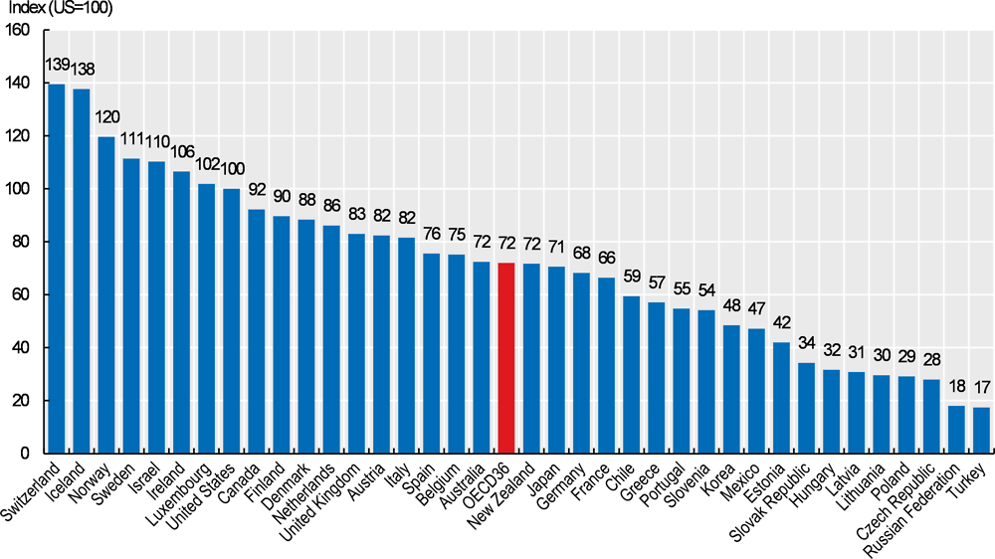
Health prices broadly reflect incomes (and a bit of policy)
Health

Slide 4
Health prices outpace other prices
Health

Slide 5
Health spending has risen in significance, 1971-2018
Health

Slide 6
Life expectancy – a 20th century success story, 1881-2017
females
males
Health

Slide 7
Healthy life expectancy is good too
Health

Slide 8
High life expectancy for $ spent
Health

Slide 9
Good value for money
Difference between actual life expectancy and life expectancy given spending per capita
Health

Slide 10
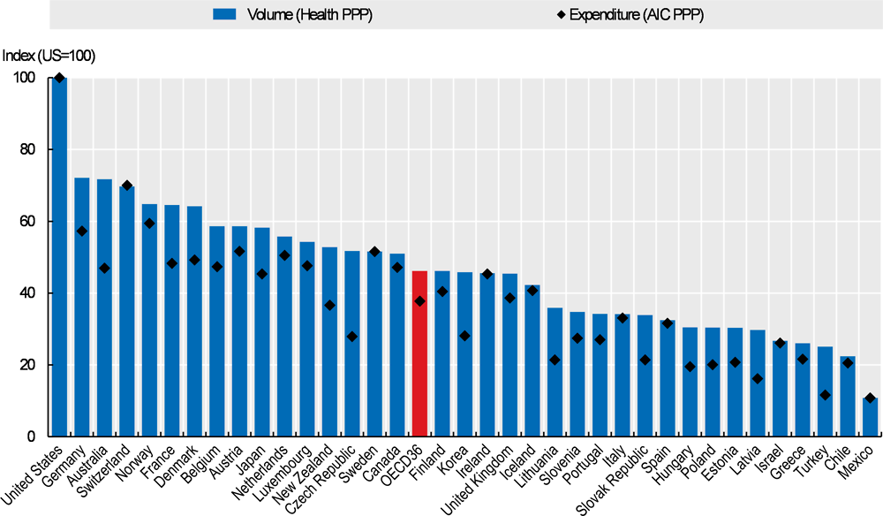
Australia has a high volume model
Health

Slide 11
Health care usage is climbing
Health

