Slide 1
OUTLOOK, JULY 2017
Peter Harris
Productivity Commission

Slide 2

Topic title

Slide 3
Contributions to income growth
Gross national income per capita
Data source: ABS 2016, Australian System of National Accounts, 2015–16, Cat. no. 5204.0, December, and Productivity Commission estimates.

Slide 4
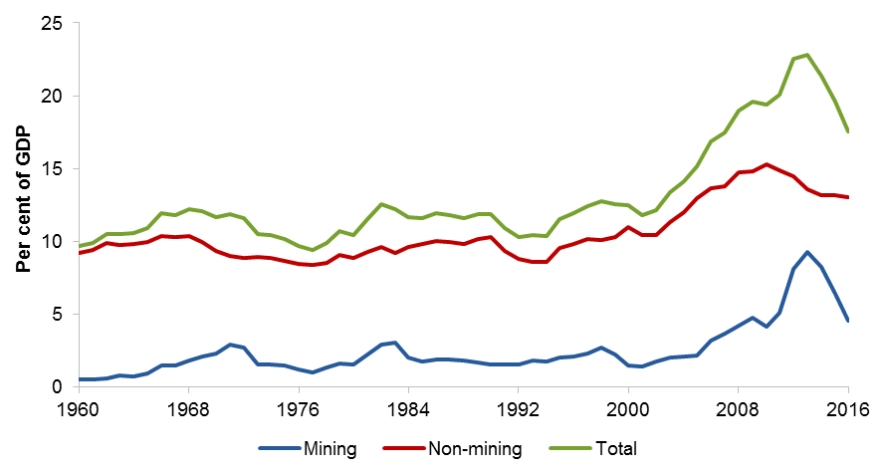
Mining and non-mining investment activity
Investment to GDP
Notes: Investment to GDP refers to real gross fixed capital formation to real gross domestic product.
Data source: ABS 2016, Australian System of National Accounts, 2015–16, Cat. no. 5204.0, December, and Productivity Commission estimates.

Slide 5
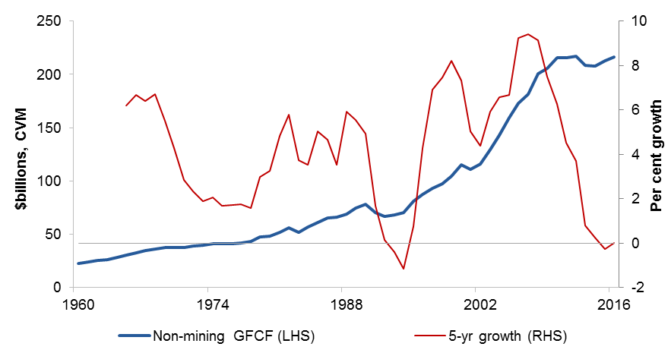
Non-mining investment growth
Non-mining investment volumes (LHS) and growth (RHS)
Note: Investment is real gross fixed capital formation, and growth is a simple five-year period end moving average.
Data source: ABS 2016, Australian System of National Accounts, 2015–16, Cat. no. 5204.0, December, and Productivity Commission estimates.

Slide 6
Where to start….
A right to return, in education
A serious spring clean of urban planning
Address disease prevention as directly as we address workplace accidents
Change the early retirement paradigm
Data, the new resource discovery
Stop creating new barriers to trade and labour mobility

Slide 7
Australia’s OECD economic ranking
Real GDP per capita in 1990 US$ (converted at Geary Khamis PPPs), OECD countries
Source: The Conference Board Total Economy Database™, May 2015, http://www.conference-board.org/data/economydatabase/; ABS (Australian System of National Accounts, 2014-15, Cat. no. 5204.0, October 2015).

Slide 8
A more open economy
Trade intensity (1970-2015)ª
ª Refers to nominal exports plus imports divided by nominal GDP.
Source: ABS Cat. nos 5302.0, 5206.0

Slide 9
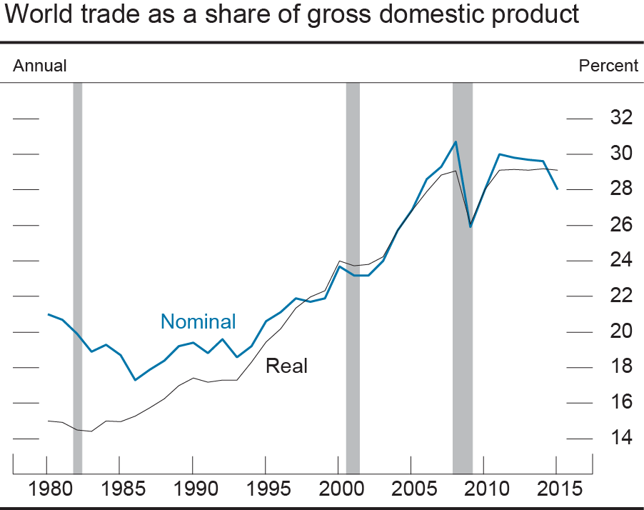
NOTE: The shaded bars indicate periods of global recession defined as 55 per cent of world gross domestic product in recession.
SOURCE: World Development Indicators, World Bank; recession data are from Economic Cycle Research Institute (ECRI).

Slide 10
Household income has improved significantly
Labour productivity and real household incomeª
ª Labour productivity is calculated as real gross domestic product per hour worked. Real household income is expressed as real gross national income per capita, per household based on Census data on average household size.
Data source: ABS Cat. No. 5204, Table 1, 6 & 72, ABS Cat. No. 6202.0, Table 6.

Slide 11
Mismatch between life expectancy and retirement policy
People are living longer, but not increasing the time spent in the workforce

