Slide 1

Superannuation
Performing for all members?
Karen Chester
Deputy Chair
McKell Institute, 6 June 2018

Slide 2
What will we cover?
Our approach
Members’
outcomes
Package of improvements
About 30 minutes
2

Slide 3
A three-stage investigation
Our approach

Slide 4
What’s new and novel
Investment benchmark portfolios (BP1 & BP2)
Cameo analysis
Econometric and stochastic analysis of products
Economies of scale analysis
Our approach

Slide 5
Data — central to the stage 3 assessment
Our approach

Slide 6
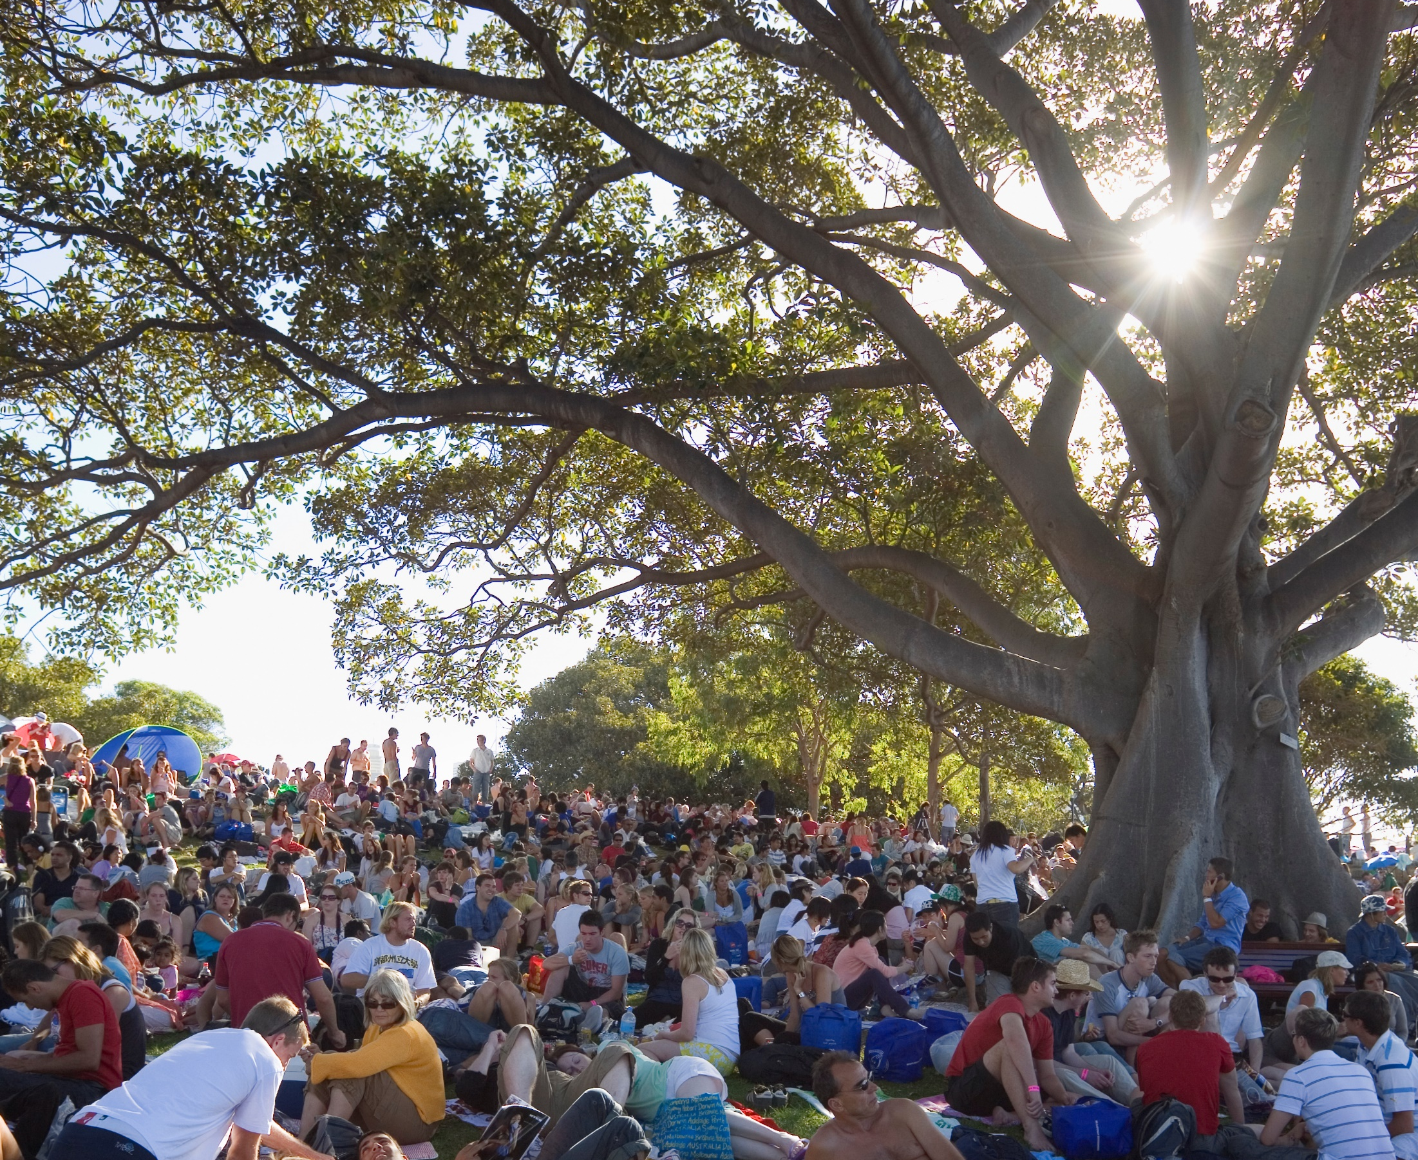
Members’ outcomes

Slide 7

Two structural flaws
Multiple
accounts
Entrenched underperformance
Members’ outcomes

Slide 8
There are too many unintended multiple accounts
Account proliferation starts early and persists, 2016
Unintended multiples
1 in 3 accounts
Members’ outcomes

Slide 9
Multiple accounts reduce retirement balances
Super problem:
Multiple
accounts =
1 years’ lost pay
Aged
21
Single super account
$833,000
$340
Retirement
$51,000
avg. insurance
Aged 67
premium
or
6
%
less
to
spend in
$50,000
retirement due to
full
multiple accounts
-
time
Multiple super accounts
starting
$782,000
salary
Members’ outcomes

Slide 10
Nearly 5 million accounts in underperforming funds Individual funds (with MySuper products), 2005–16
6
47
9.8 million member accounts
67%
5
funds above
$448 billion in
assets
68%
relative to BP2 over 10 years (%)
4
benchmark
3
Annual net returns
2
1
0
BP2
BP2 – 0.25%
-
1
-
2
20
-
4.6 million member accounts
31%
3
funds
$197 billion in
assets
30%
-
4
underperform
-
5
Retail
Industry
Corporate
Public sector
-
6
Data source: APRA fund-level data and financial market index data (various providers)
Benchmark: Fund-tailored BP2
Coverage: All APRA-regulated funds with a MySuper product in the dataset over the full period (52% of assets and 61% of member accounts in all APRA‑regulated funds with a MySuper product in 2016). Over the entire super system, the figure represents 74 funds, 32% of assets and 50% of member accounts in 2016 (and is subject to survivor and selection bias).
Members’ outcomes

Slide 11
Underperformance compounds to a substantially lower retirement balance
Super problem
:
Underperforming fund = 13 years’ lost pay
Aged
21
Top quartile fund returns
$1.2 million
$
340
Retirement
$635,000
avg. insurance
Aged 67
premium
or
53% less
to
spend in
$50,000
retirement due
full
Bottom quartile fund
returns
lower returns
-
time
starting
$568,000
salary
Members’ outcomes

Slide 12
1.7 million accounts in underperforming default (2008–17)
3
10
6.1 million member accounts
55%
2
best performing
$225 billion in assets
48%
default products
1
Annual net returns relative to BP2 over 10 years (%)
0
BP2
BP2 - 0.25%
-
1
26
1.7 million member accounts
15%
-
2
underperforming
$62 billion in assets
13%
default products
Retail
Industry
Corporate
Public Sector
-
3
Data source: SuperRatings and APRA data and financial market index data (various providers)
Benchmark: Segment tailored BP2
Coverage: The figure represents 66 of 108 MySuper products covering 75% of member accounts and 73% of assets in all MySuper products as at December 2017 (and is subject to survivor and selection bias.)
Members’ outcomes

Slide 13
MySuper can be a lottery for default members
Super problem: Underperforming MySuper = 7.5 years’ lost pay
Aged 21
Top-10 MySuper return
$1 million
$340 avg. insurance premium
Retirement aged 67
$375,000
or 36% less to spend in retirement due to lower returns
$50,000 full-time starting salary
Underperforming MySuper
$653,000
Members’ outcomes

Slide 14
Substantial tail of underperforming choice options, 2005–16
Based on analysis of 362 accumulation options with an estimated $133 billion in assets
4
172
options above benchmark
$75.5 billion in assets
57%
0
BP1
BP1 - 0.25%
172
underperforming options
$53.7 billion in assets
40%
-4
Retail
Industry
Corporate
Public sector
Data source: SuperRatings data and financial market index data (various providers)
Benchmark: Option tailored BP1
Coverage: 362 accumulation options from APRA‑regulated funds with an estimated $133 billion in assets (or 13 per cent) in the choice segment. (Figure is subject to survivor and selection bias.)
Members’ outcomes

Slide 15
Other problems
Fees erode balances
Over 40,000 products to compare
Zombie insurance you can’t claim on
Members’ outcomes

Slide 16
Today’s members — evolved needs
Members’ outcomes

Slide 17
Package of improvements
Health
17

Slide 18
New default mechanism: employee choice
Inspired by behavioural economics
Members who default do so only once
Best in show shortlist
Elevated MySuper threshold
Improvements

Slide 19
Where will members go?
Improvements

Slide 20
How will members benefit?
Most new entrants best performers
Few new defaults
Benefits of competition unlocked
Benefits spill over to other members
Improvements

Slide 21
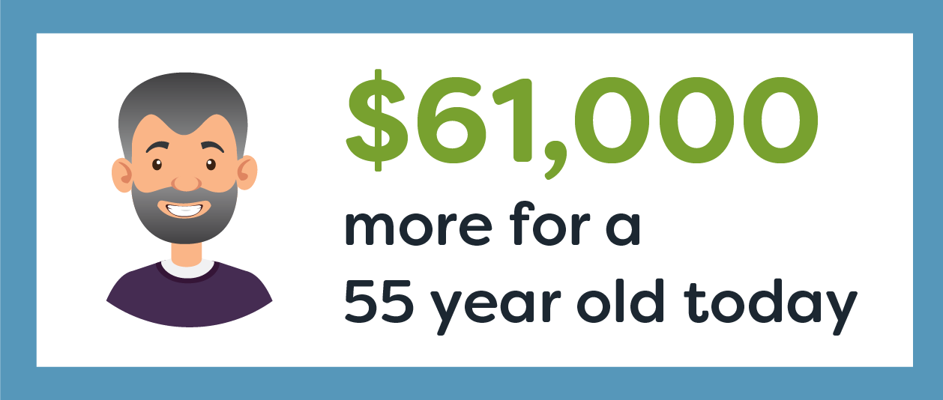
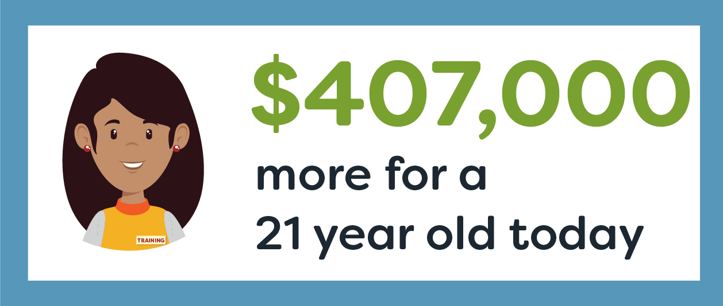
The policy upside
Members’ outcomes

Slide 22
Other elements of the package
Products and information that meet members’ needs
Insurance that works for members
Best practice fund governance
Regulators that are member champions
Improvements

Slide 23
Next steps
Post-draft timeline
Draft report release 29 May
Public hearings 20–22 June
Funds
survey II 27 June
Subs due
13 July
3 post-draft
supplements mid August
Workshops
late August
Final report
late 2018

Slide 24
Questions?
Attribution (Icons by the Noun project)
Water drop by Nick Bluth
Superhero by Juan Pablo Bravo

