Slide 1
An overview of Australia’s productivity performance
Shiji Zhao
Productivity Commission
PC-ABS Productivity Perspective Conference 2012, Canberra
20th November 2012

Slide 2
Outline
Australia’s productivity performance of market sector
  Recent development
Productivity at industry level
  Recent development; and
  Trend over a longer period
Contribution of changes in the composition of human capital to
  Labour productivity
  Economic growth
Key messages

Slide 3
Multifactor productivity

Slide 4
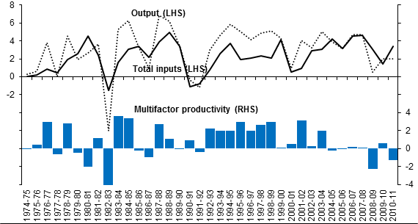
Multifactor productivity growth

Slide 5
Industry MFP growth rates

Slide 6
Causes for the slowdown in Mining and Utility
Lumpy investment
  Both mining and utility industries
Depletion of natural resources
  Mining industry
Technology change
  Electricity supply
Imperfect (output) measurement
  Water supply

Slide 7
Further information (www.pc.gov.au)
Topp, V., Soames, L., Parham, D. and Bloch H., (2008) Productivity in the Mining Industry: Measurement and Interpretation, Productivity Commission Staff Working Paper, December
Topp, V. and Kulys, T. (2012) Productivity in Electricity, Gas and Water: Measurement and Interpretation, Productivity Commission Staff Working Paper, Canberra

Slide 8
MFP growth by industry

Slide 9
MFP growth between 1985-86 to 2010-11

Slide 10
Indexes of labour input for the 12 industry market sector
157.7
134.9

Slide 11
Labour Productivity Indexes for the 12 industry market sector
195.1
167.2

Slide 12
Decomposition of Real Gross Domestic Income (GDI)

Slide 13
GDI Decomposition

Slide 14
Key messages
In the recent decade, MFP growth slowed down
  For the market sector as a whole and across many industries
  Mining and utility industries
Long term productivity performance was diverse across industries
The effect of human capital made a significant contribution to the growth of Australia’s real income

