Slide 1
The Industry Sources of Australia’s Productivity Slowdown
Hui Wei
Pengfei Zhao
Australian Bureau of Statistics

Slide 2
Overview
Background
Methodology
Empirical results
Concluding remarks

Slide 3
Background
Key issues
Is there a productivity slowdown and how severe
How individual industries contribute to the slowdown
Is slowdown cyclical or due to structural change
The ABS productivity statistics
Aggregate labour and MFP statistics
Industry level datacube
Contribution of this study
Integrate aggregate productivity statistics with industry level details
Quantitative assessments of contributions of individual industries to aggregate productivity performance

Slide 4



Decomposition of ALP (Stiroh 2002)
Aggregate output growth
Industry gross output
Decomposition of ALP

Slide 5
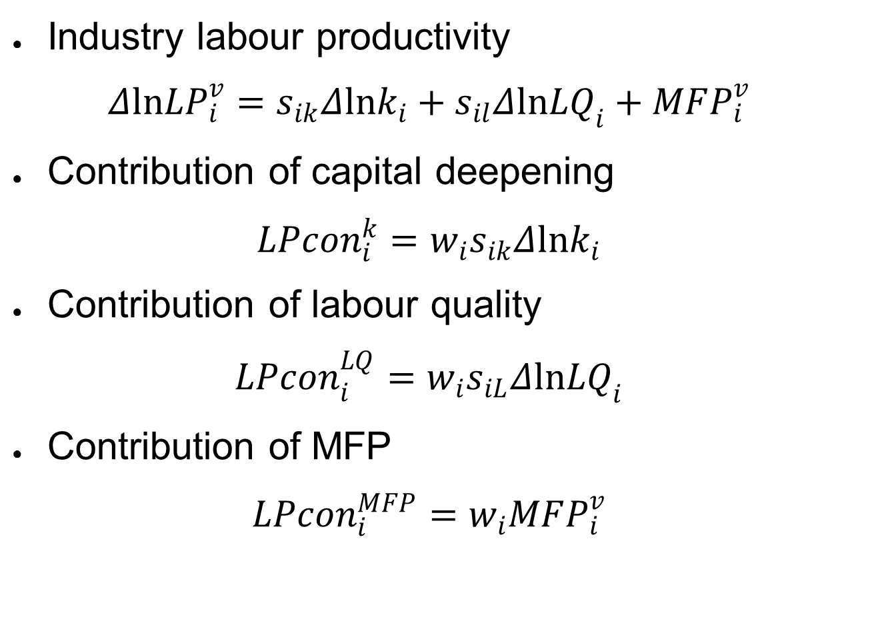
Industry Contributions to Aggregate Productivity Growth (Timmer et al. 2010)

Slide 6
Data
ABS Industry MFP datacube
Confined to 12 industries
Cover the period 1994-95 to 2009-10
Two sub-periods: 1994-95 to 2003-2004 and 2003-04 to 2009-10
Separate measures of IT capital assets
Measures of quality adjusted labour input at industry level

Slide 7
Industry Sources of Aggregate Labour Productivity Growth
 | 1994-95 to 2003-04 | 2003-04 to 2009-10 | 1994-95 to 2009-10 | 2003-04 to 2009-10 less 1994-95 to 2003-04
Aggregate labour productivity growth | 3.20 | 1.84 | 2.53 | -1.36
Decomposition using gross output productivity
Weighted | 2.92 | 1.08 | 2.00 | -1.85
Material reallocation | -0.36 | 0.00 | -0.25 | 0.36
Hours reallocation | -0.09 | 0.76 | 0.29 | 0.85
Decomposition using value added productivity
Weighted | 3.29 | 1.08 | 2.24 | -2.21
Hours reallocation | -0.09 | 0.76 | 0.29 | 0.85
Contribution of industry weighted
IT capital per hour | 0.75 | 0.55 | 0.65 | -0.20
Non-IT capital per hour | 0.75 | 0.67 | 0.71 | -0.08
Labour composition | 0.24 | 0.20 | 0.23 | -0.05
Multi-factor productivity | 1.54 | -0.34 | 0.66 | -1.88
Notes: All figures are average annual percentages. The weights used to calculate the direct industry contributions are industry shares in aggregate nominal value added. IT capital includes computer software and computers.

Slide 8
Industry Decomposition of Aggregate Labour Productivity Growth
1994-95 to 2003-04
Industry | Direct effect (GO labour productivity) | Material reallocation | Direct effect (VA labour productivity) | Labour hour reallocation | Aggregate labour productivity growth
A Agriculture, Forestry and Fishing | 0.28 | -0.09 | 0.38 | 0.04 | 0.41
B Mining | 0.09 | -0.05 | 0.13 | 0.05 | 0.18
C Manufacturing | 0.74 | 0.08 | 0.65 | 0.00 | 0.66
D Electricity, Gas, Water and Waste Services | 0.06 | -0.01 | 0.07 | -0.01 | 0.07
E Construction | 0.11 | -0.09 | 0.20 | -0.08 | 0.12
F Wholesale Trade | 0.39 | 0.08 | 0.32 | 0.00 | 0.32
G Retail Trade | 0.05 | -0.18 | 0.23 | -0.12 | 0.10
H Accommodation and Food Services | 0.13 | 0.04 | 0.09 | -0.08 | 0.01
I Transport, Postal and Warehousing | 0.13 | -0.10 | 0.22 | 0.00 | 0.22
J Information, Media and Telecommunication | 0.30 | 0.04 | 0.27 | 0.03 | 0.29
K Financial and Insurance Services | 0.61 | -0.08 | 0.69 | 0.10 | 0.79
R Arts and Recreation Services | 0.03 | 0.00 | 0.03 | -0.01 | 0.02
12 industries | 2.92 | -0.36 | 3.29 | -0.09 | 3.20
Notes: All figures are average annual percentages. GO stands for gross output; VA stands for value added. is the difference between an industry’s share in aggregate value added and its share in aggregate labour hours. is the two-period moving average ratio of nominal industry intermediate inputs to nominal aggregate value added. Contributions to labour productivity may not sum to totals due to rounding errors.

Slide 9
Industry Decomposition of Aggregate Labour Productivity Growth 2003-04 to 2009-10
Industry | Direct effect (GO labour productivity) | Material reallocation | Direct effect (VA labour productivity) | Labour hour reallocation | Aggregate labour productivity growth
A Agriculture, Forestry and Fishing | 0.17 | -0.10 | 0.27 | 0.00 | 0.26
B Mining | -0.59 | 0.03 | -0.62 | 0.78 | 0.15
C Manufacturing | 0.55 | 0.28 | 0.27 | 0.02 | 0.29
D Electricity, Gas, Water and Waste Services | -0.19 | -0.01 | -0.19 | 0.13 | -0.06
E Construction | 0.12 | 0.07 | 0.04 | -0.18 | -0.14
F Wholesale Trade | 0.17 | 0.04 | 0.13 | 0.01 | 0.14
G Retail Trade | 0.11 | -0.12 | 0.23 | -0.05 | 0.18
H Accommodation and Food Services | 0.00 | 0.00 | 0.00 | -0.06 | -0.07
I Transport, Postal and Warehousing | 0.08 | 0.01 | 0.06 | -0.01 | 0.05
J Information, Media and Telecommunication | 0.23 | -0.03 | 0.27 | -0.02 | 0.25
K Financial and Insurance Services | 0.43 | -0.17 | 0.61 | 0.19 | 0.79
R Arts and Recreation Services | 0.02 | 0.00 | 0.02 | -0.03 | -0.01
12 industries | 1.08 | 0.00 | 1.08 | 0.76 | 1.84
Notes: All figures are average annual percentages. GO stands for gross output; VA stands for value added. is the difference between an industry’s share in aggregate value added and its share in aggregate labour hours. is the two-period moving average ratio of nominal industry intermediate inputs to nominal aggregate value added. Contributions to labour productivity may not sum to totals due to rounding errors.

Slide 10
Contribution of IT Capital Deepening
 | 1994-95 to 2003-04 | 2003-04 to 2009-10 | 1994-95 to 2009-10 | 2003-04 to 2009-10 less 1994-95 to 2003-04
12 industries | 0.749 | 0.550 | 0.649 | -0.198
Contribution of:
A Agriculture, Forestry and Fishing | 0.006 | 0.003 | 0.005 | -0.003
B Mining | 0.020 | 0.011 | 0.016 | -0.010
C Manufacturing | 0.134 | 0.090 | 0.111 | -0.044
D Electricity, Gas, Water and Waste Services | 0.043 | 0.020 | 0.032 | -0.024
E Construction | 0.034 | 0.032 | 0.033 | -0.002
F Wholesale Trade | 0.064 | 0.066 | 0.063 | 0.002
G Retail Trade | 0.053 | 0.055 | 0.052 | 0.003
H Accommodation and Food Services | 0.009 | 0.010 | 0.009 | 0.001
I Transport, Postal and Warehousing | 0.025 | 0.030 | 0.027 | 0.005
J Information, Media and Telecommunication | 0.097 | 0.044 | 0.073 | -0.053
K Financial and Insurance Services | 0.251 | 0.181 | 0.218 | -0.070
R Arts and Recreation Services | 0.012 | 0.009 | 0.011 | -0.004
Notes: All figures are average annual percentages. The contributions are share-weighted growth rates.

Slide 11
Contribution of Non-IT Capital Deepening
 | 1994-95 to 2003-04 | 2003-04 to 2009-10 | 1994-95 to 2009-10 | 2003-04 to 2009-10 less 1994-95 to 2003-04
12 industries | 0.751 | 0.673 | 0.713 | -0.079
Contribution of:
A Agriculture, Forestry and Fishing | 0.062 | 0.053 | 0.055 | -0.009
B Mining | 0.136 | -0.067 | 0.069 | -0.203
C Manufacturing | 0.249 | 0.343 | 0.269 | 0.093
D Electricity, Gas, Water and Waste Services | 0.050 | -0.029 | 0.016 | -0.079
E Construction | -0.035 | 0.005 | -0.007 | 0.040
F Wholesale Trade | 0.064 | 0.084 | 0.068 | 0.019
G Retail Trade | 0.022 | 0.057 | 0.036 | 0.035
H Accommodation and Food Services | 0.016 | 0.018 | 0.017 | 0.002
I Transport, Postal and Warehousing | 0.031 | 0.079 | 0.054 | 0.048
J Information, Media and Telecommunication | 0.133 | 0.191 | 0.150 | 0.058
K Financial and Insurance Services | 0.005 | -0.062 | -0.025 | -0.067
R Arts and Recreation Services | 0.017 | 0.002 | 0.009 | -0.015
Notes: All figures are average annual percentages. The contributions are share-weighted growth rates.

Slide 12
Contribution of Labour Quality Growth
 | 1994-95 to 2003-04 | 2003-04 to 2009-10 | 1994-95 to 2009-10 | 2003-04 to 2009-10 less 1994-95 to 2003-04
12 industries | 0.244 | 0.196 | 0.225 | -0.049
Contribution of:
A Agriculture, Forestry and Fishing | 0.009 | 0.004 | 0.007 | -0.004
B Mining | 0.008 | 0.000 | 0.005 | -0.008
C Manufacturing | 0.066 | 0.042 | 0.056 | -0.024
D Electricity, Gas, Water and Waste Services | 0.010 | 0.003 | 0.007 | -0.007
E Construction | 0.012 | -0.001 | 0.007 | -0.013
F Wholesale Trade | 0.024 | 0.034 | 0.028 | 0.010
G Retail Trade | 0.016 | 0.017 | 0.016 | 0.001
H Accommodation and Food Services | 0.005 | 0.006 | 0.005 | 0.001
I Transport, Postal and Warehousing | 0.019 | 0.011 | 0.016 | -0.008
J Information, Media and Telecommunication | 0.012 | 0.010 | 0.011 | -0.002
K Financial and Insurance Services | 0.061 | 0.068 | 0.064 | 0.007
R Arts and Recreation Services | 0.004 | 0.002 | 0.003 | -0.002
Notes: All figures are average annual percentages. The contributions are share-weighted growth rates.

Slide 13
Contribution of Industry MFP Growth
 | 1994-95 to 2003-04 | 2003-04 to 2009-10 | 1994-95 to 2009-10 | 2003-04 to 2009-10 less 1994-95 to 2003-04
Domar-Weighted MFP | 1.540 | -0.342 | 0.657 | -1.882
Contributions
A Agriculture, Forestry and Fishing | 0.298 | 0.205 | 0.195 | -0.093
B Mining | -0.032 | -0.565 | -0.242 | -0.533
C Manufacturing | 0.206 | -0.207 | 0.015 | -0.413
D Electricity, Gas, Water and Waste Services | -0.030 | -0.178 | -0.089 | -0.148
E Construction | 0.191 | 0.006 | 0.126 | -0.185
F Wholesale Trade | 0.167 | -0.054 | 0.074 | -0.221
G Retail Trade | 0.137 | 0.102 | 0.109 | -0.036
H Accommodation and Food Services | 0.061 | -0.038 | 0.019 | -0.099
I Transport, Postal and Warehousing | 0.148 | -0.057 | 0.076 | -0.205
J Information, Media and Telecommunication | 0.024 | 0.024 | 0.014 | 0.000
K Financial and Insurance Services | 0.372 | 0.418 | 0.364 | 0.046
R Arts and Recreation Services | -0.002 | 0.003 | -0.005 | 0.005
Notes: All figures are average annual percentages.

Slide 14
Growth Accounting Results for Aggregate Labour Productivity
Decomposition using value added productivity, from 1994-95 to 2003-04

Slide 15
Growth Accounting Results for Aggregate Labour Productivity
Decomposition using value added productivity, from 2003-04 to 2009-10

Slide 16
Concluding Remarks
The impact on aggregate productivity of the mining boom and structural change is significant. The shift to high-productivity-level mining industry accounted for more than 40% of ALP growth
IT capital deepening played a significant role in Australia’s productivity surge for the period between mid 1990s and early 2000s.
The role of human capital in productivity growth has been limited in Australia
MFP has been the dominant driver of labour productivity growth, and recent poor MFP performance is attributable to Mining, Manufacturing, and Utility industries
Looming positive signs of productivity outlook
Mining projects will deliver outputs
Innovative efforts by mining companies will bear fruits

